Slide 1

Unconscious bias & stereotypes in the workplace
Andrea Brewster OBE
Lead Executive Officer, IP Inclusive
19 February 2020

Slide 2

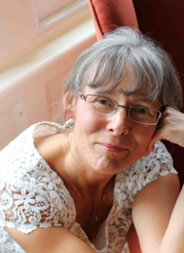
Biography: Andrea Brewster OBE
Andrea is a Chartered Patent Attorney and European Patent Attorney. Until her retirement in 2015 she was a partner in the Somerset firm Greaves Brewster LLP, of which she had been a co-founder.
A former President of CIPA, Andrea is a member of the Institute’s governing Council and serves on several of its committees, including the Education Committee, the Joint CIPA & CITMA Business Practice Committee and the IP Paralegals’ Committee (which she helped to establish).
Andrea is the founder and Lead Executive Officer of IP Inclusive, an initiative that promotes diversity and inclusion (D&I) throughout the IP professions. She regularly speaks on D&I-related topics in the IP sector, including mental wellbeing in the workplace. In her spare time, she writes a light-hearted blog about her work: thenotsosecretdiary.weebly.com

Slide 3
Unconscious bias & stereotypes in the workplace
Andrea Brewster OBE
Lead Executive Officer, IP Inclusive
19 February 2020

Slide 4
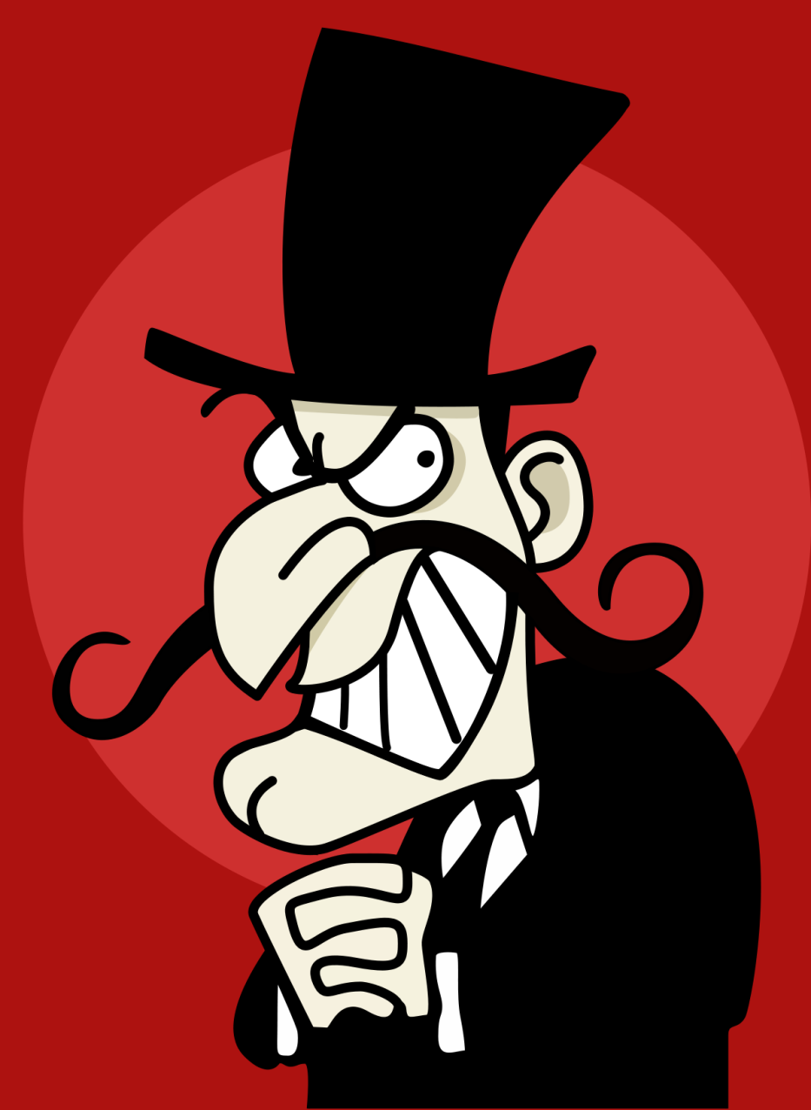
Before we start…

Slide 5
What we’ll cover
What is “unconscious bias” and why does it happen?
Why and where does it cause problems?
Typical types of unconscious bias in the workplace
What can we do about it?

Slide 6
What is “unconscious bias”?
Key types of bias:
Conscious:
Malicious (eg racism, sexism, homophobia)
Not exactly malicious, but based on inappropriate stereotypes and generalisations

Slide 7

Let’s make some
sweeping generalisations
Boys are better at maths and science
Women are better at multi-tasking
Young people are better with technology
Anxious people can’t handle the stress of IP work
People with children are inflexible
Older people are more resistant to change

Slide 8
What is “unconscious bias”?
Key types of bias:
Unconscious:
Without realising, making an unjustified assumption about someone or something, often based on what you’ve already experienced

Slide 9
What is “unconscious bias”?
Key types of bias:
Unconscious:
Without realising, making an unjustified assumption about someone or something, often based on what you’ve already experienced

Slide 10
What is “unconscious bias”?
Key types of bias:
Unconscious:
Without realising, making an unjustified assumption about someone or something, often based on what you’ve already experienced

Slide 11
Why does it happen?
The way we’re wired
The brain processes 11,000,000 bits of information per second
The brain consciously process 40 bits of information per second
We categorise to cope, to shortcut decision-making
We rely on patterns, categorisation, assumptions and generalisations

Slide 12


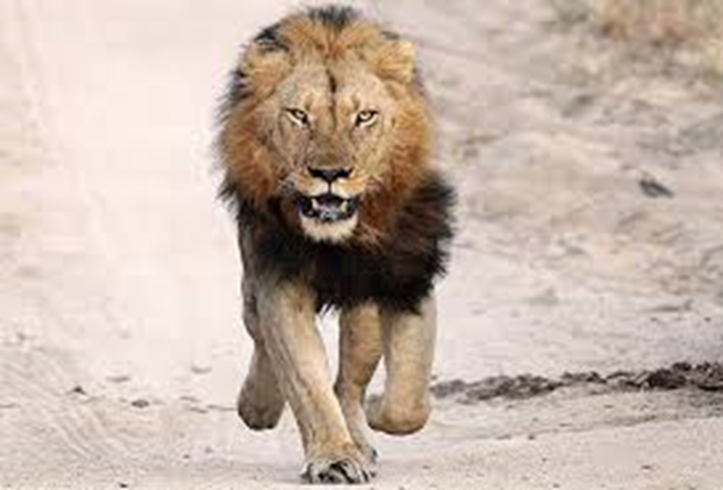

Slide 13
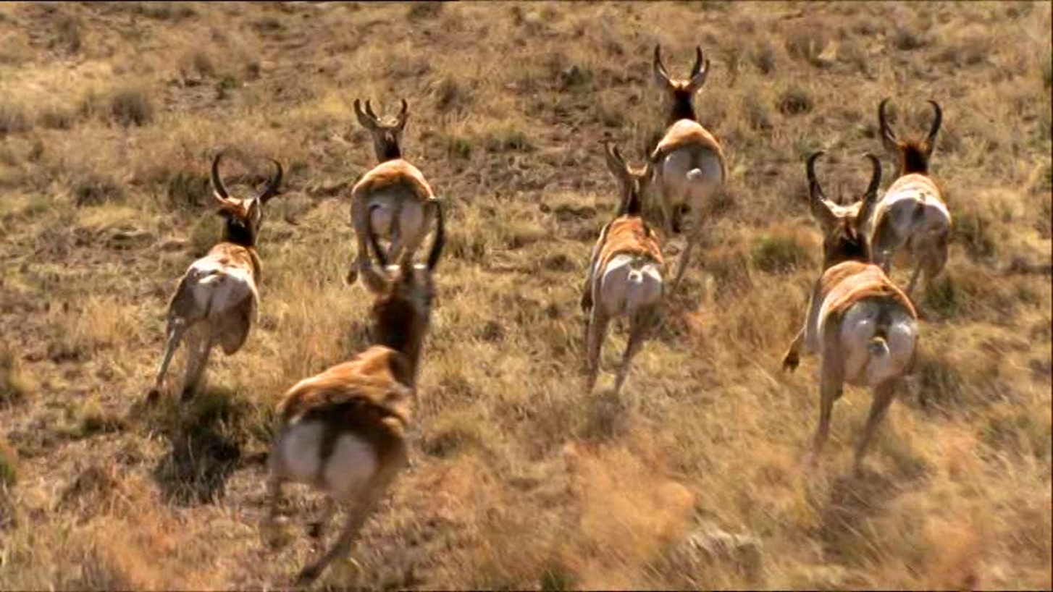

Slide 14


Slide 15
Stereotypes
The way we learn
A lot of our unconscious biases are learned:
From our own observations and experiences

Slide 16
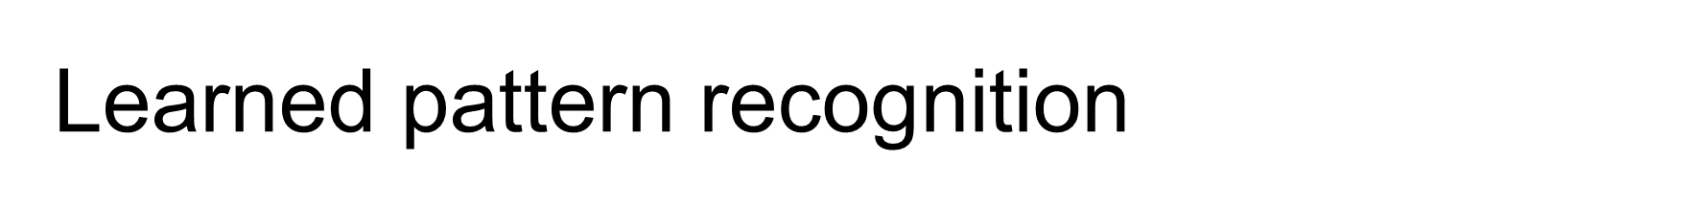
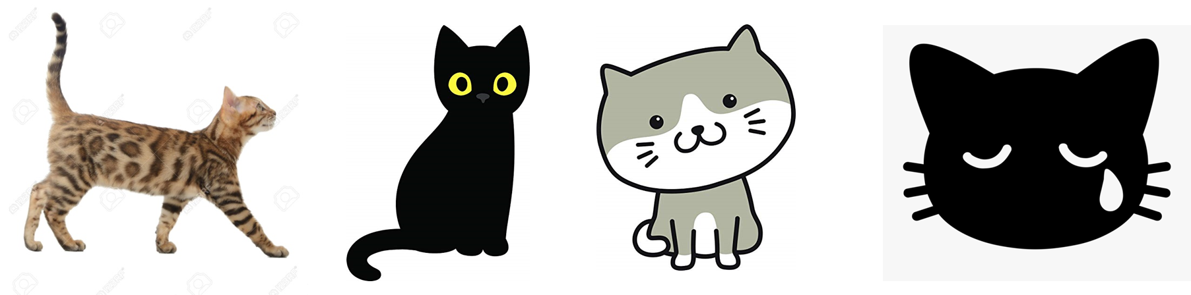

Slide 18
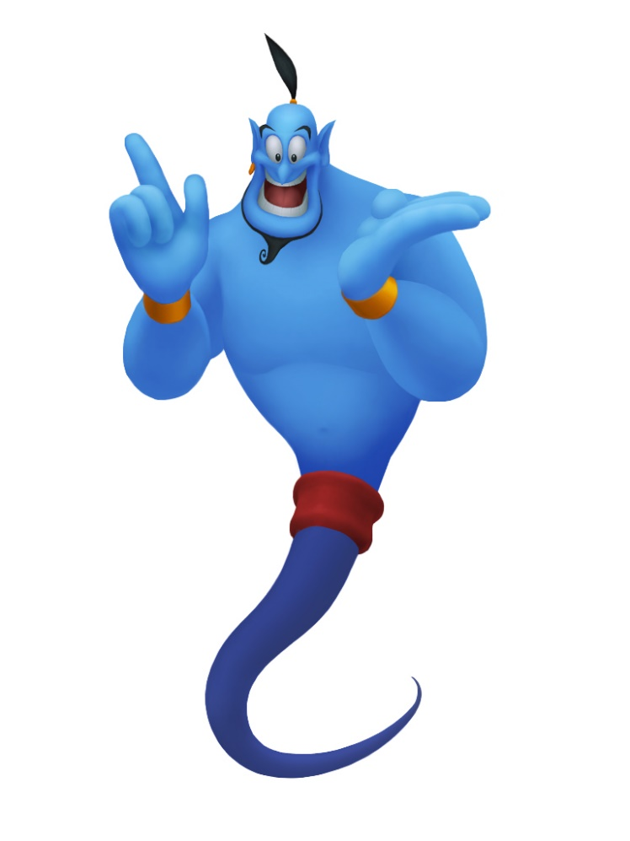
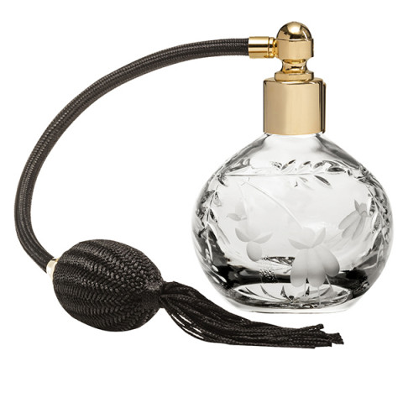

Slide 19
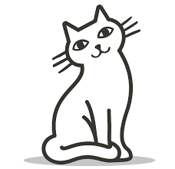

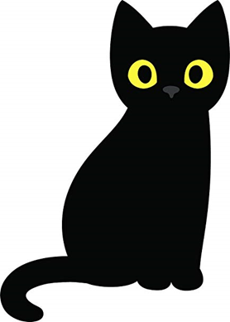

Slide 20
How do we acquire these “biases”?
The way we learn
A lot of our unconscious biases are learned:
From our own observations and experiences
From other people: family, friends, teachers, the wider media
Cultural and societal influences affect the way we see things and the assumptions we make
We pick up on stereotypes and prejudices, and they influence our decisions

Slide 21
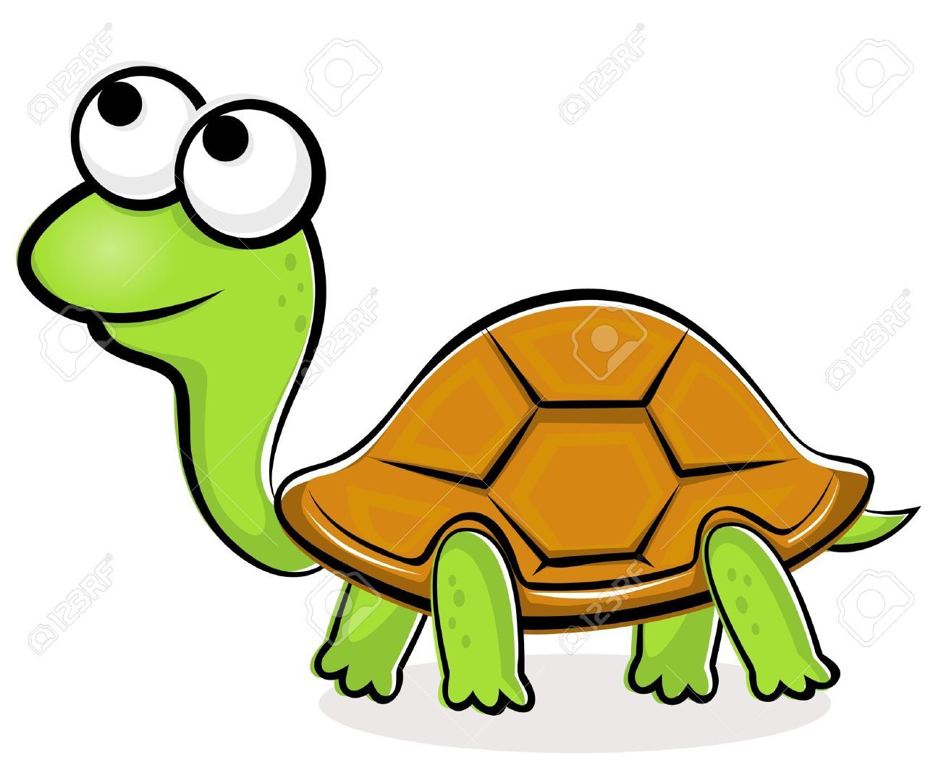

Slide 22
Why does it happen?
“A Class That Turned Around Kids' Assumptions of Gender Roles”
https://youtu.be/G3Aweo-74kY

Slide 23
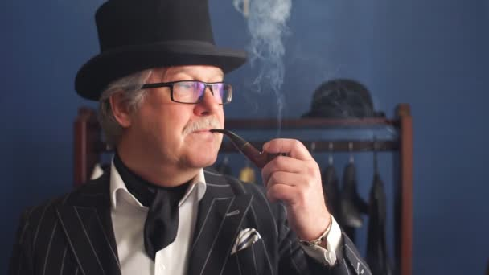
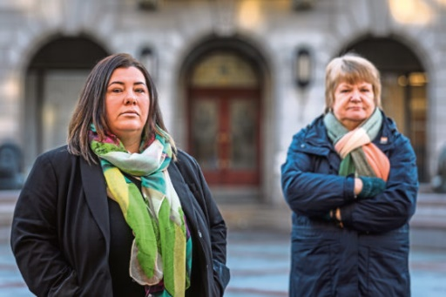
Stereotypes & prejudices

Slide 24

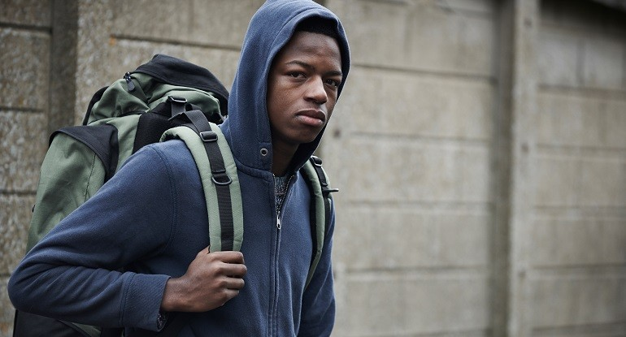
Stereotypes & prejudices

Slide 25
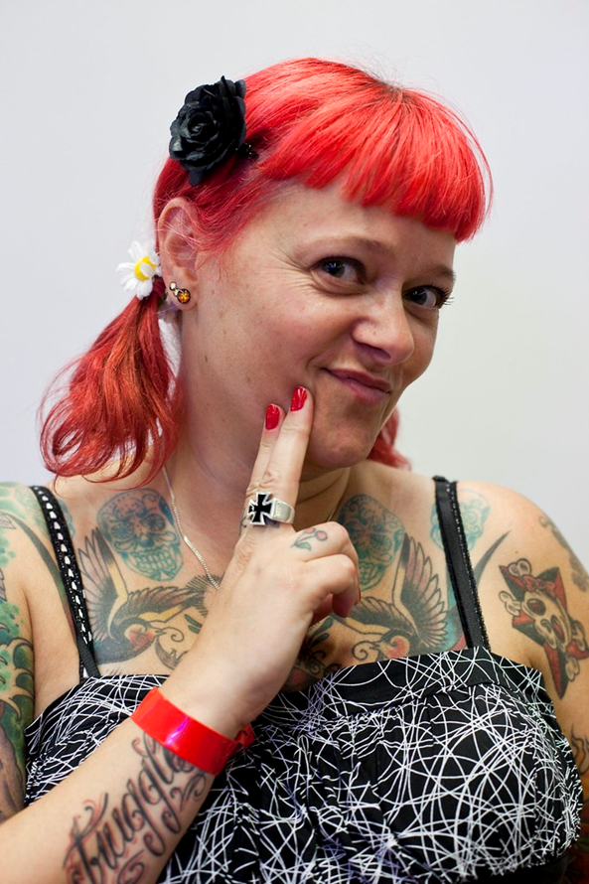

Slide 26
Stereotypes & prejudices

Slide 27
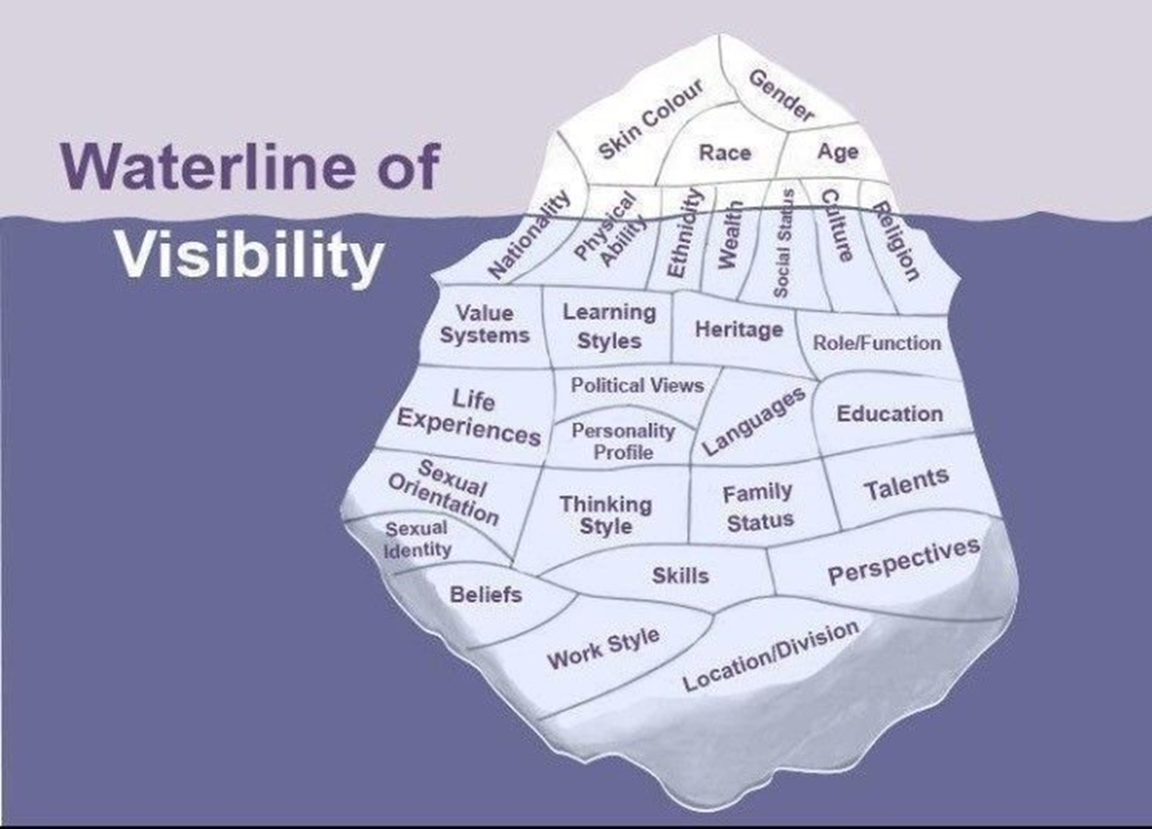

Slide 28
Types of unconscious bias
We have unconscious biases about:
People
Roles (eg what’s needed to be an IP solicitor)
Success indicators (eg what a good IP solicitor looks like)
Situations (eg approaching threats or opportunities)
Data and its meaning

Slide 29

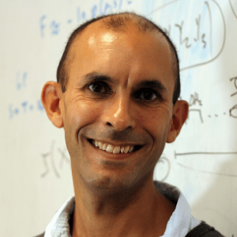
“…we're always hallucinating.
It’s just that when we agree about our hallucinations,
that’s what we call reality.”
Anil Seth

Slide 30
Key types of unconscious bias (1)
“Affinity bias”

Slide 31
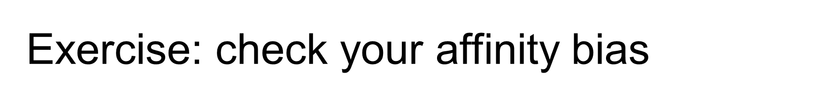
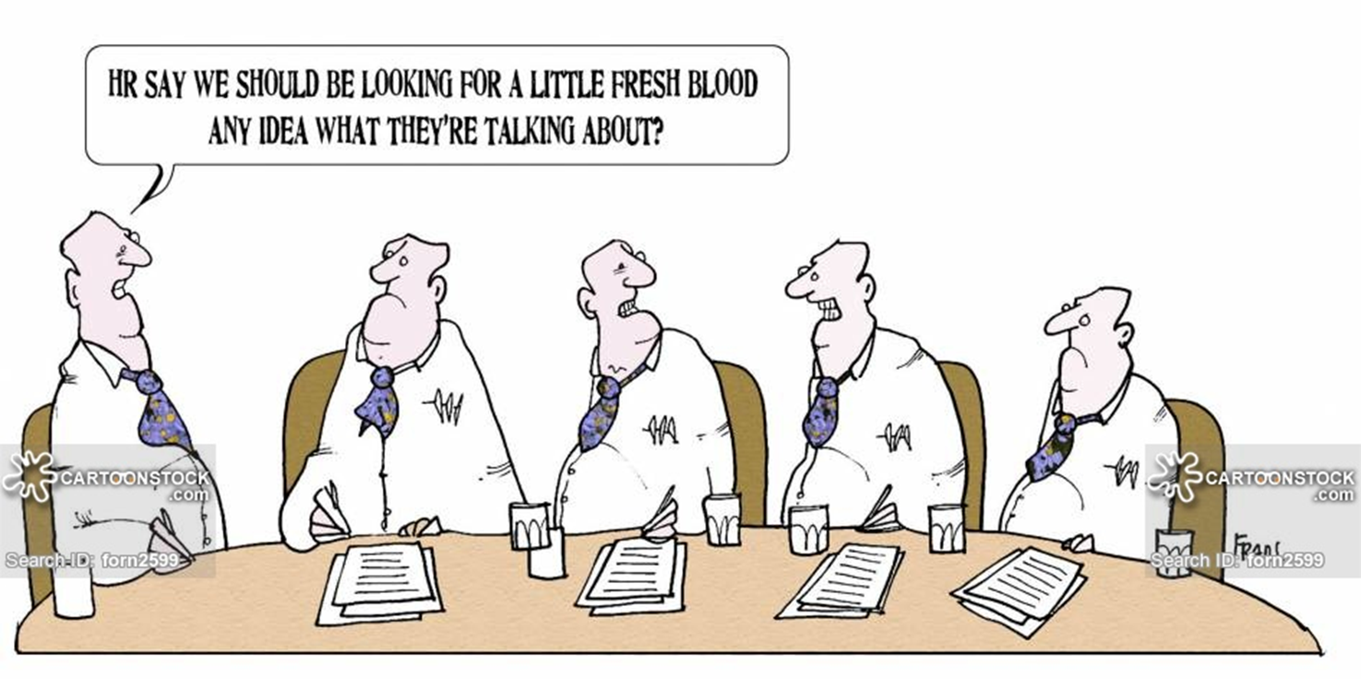

Slide 32
Key types of unconscious bias (1)
“Affinity bias”
Preferring people who are more like us
Recruiting in our own image
Forming “in-groups” and “out-groups”
Allowing social interactions to affect our judgements about work-related issues

Slide 33
Key types of unconscious bias (2)
“Groupthink”

Slide 35
Key types of unconscious bias (2)
“Groupthink”
Everyone agrees with everyone else
Everyone thinks in the same way
Even if they don’t, they daren’t speak up or challenge the consensus
This can lead to very bad (but ironically also very confident) decisions

Slide 36
Key types of unconscious bias (3)
“False consensus”

Slide 37
Key types of unconscious bias (3)
“False consensus”
The assumption that everyone thinks and feels the same way as we do
And knows and understands the same things we do
Reinforces groupthink
And complacency

Slide 38
Key types of unconscious bias (3)
“False consensus”
Hampers communications with colleagues, clients, potential clients, suppliers, tribunals
(Why doesn’t the tribunal get the point I’m making? How can this client not understand the issues? Why does this person not seem comfortable with me? What don’t people like about our 50-page brochure?)
Leads us to assume other people are wrong, or stupid

Slide 39
Key types of unconscious bias (4)
“Confirmation bias”

Slide 40
Key types of unconscious bias (4)
“Confirmation bias”
Only looking for evidence that proves us right
Selective filtering (of inconvenient truths)
Selective blindness/deafness (to something or someone we’ve already discounted)
Seeing what we expect to see (eg proof-reading mistakes)

Slide 41
Key types of unconscious bias (5)
“Clustering illusion” …and similar effects

Slide 42
Key types of unconscious bias (5)
“Clustering illusion” and other similar effects
Seeing clusters where there aren’t any, or “phantom patterns”

Slide 43
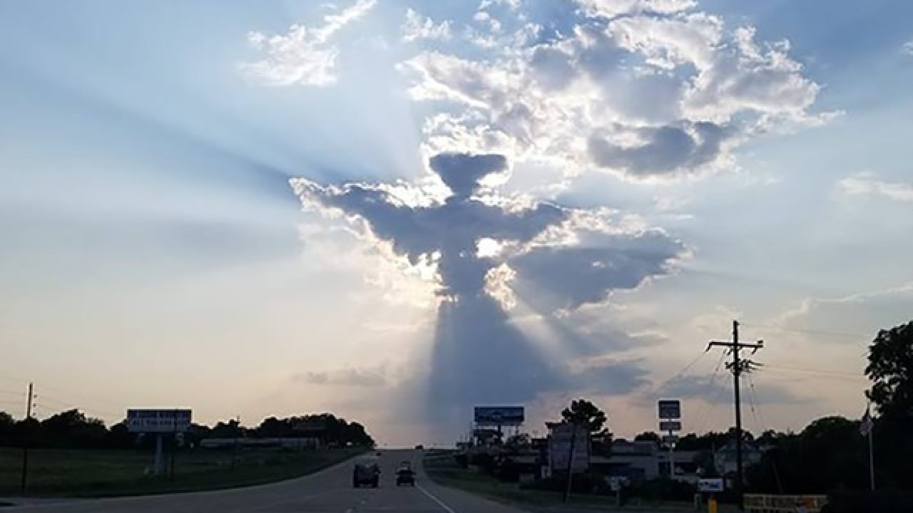

Slide 44
Key types of unconscious bias (5)
“Clustering illusion” and other similar effects
Seeing clusters where there aren’t any, or “phantom patterns”
Over-generalisation and extrapolation:
(“She always has Mondays off”; “He makes more mistakes than anyone else”)
Often linked to other biases
Eg false consensus; confirmation bias

Slide 45
Key types of unconscious bias (6)
“Priming” effects

Slide 46
Key types of unconscious bias (6)
“Priming” effects
(Observational) selection bias
The tendency to notice something more when something causes us to be more aware of it
Seeing what we’ve been “primed” to see

Slide 47

A vase

Slide 48
Two people talking

Slide 49
Key types of unconscious bias (7)
“Thin-slicing”

Slide 50
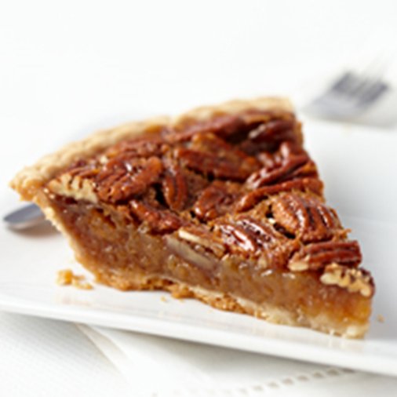
Key types of unconscious bias (6)
“Thin-slicing”
Judging on first impressions

Slide 52
Other types of unconscious bias
…There are plenty…
Check out Wikipedia on “cognitive bias”

Slide 53
Other types of unconscious bias
The best one of all:
Bias blind spot
Thinking we’re not biased

Slide 54
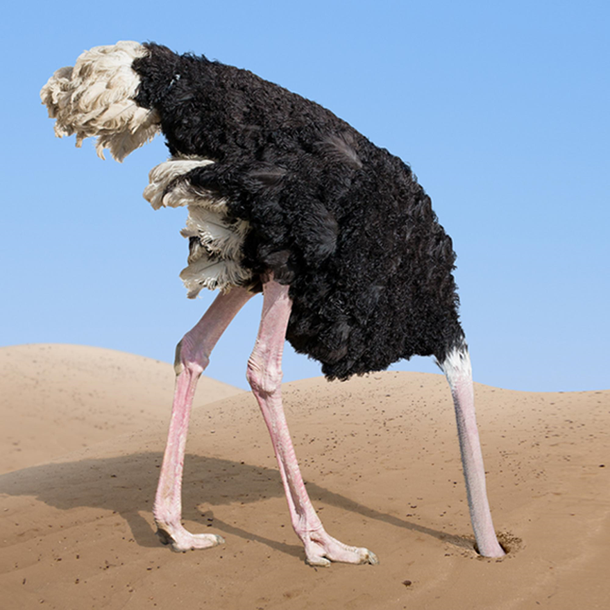

Slide 55
Where does unconscious bias arise?
Everywhere!
Unconscious bias can affect all manner of work-related decisions, about:
People
Performance
Current situations
Future plans
Data analysis
It also impacts on how we communicate with people

Slide 56
Where does unconscious bias arise?
Recruitment and selection
Performance appraisal
Promotion and career development
Including salary reviews
Training and support

Slide 57
Where does unconscious bias arise?
Creating teams, committees, etc
Affinity bias is a big problem
Reluctance to “shake things up a bit”
Leading, in turn, to groupthink
Allocation of roles, responsibilities and tasks
Working arrangements: location, timing, flexibility, supporting resources

Slide 58
Where does unconscious bias arise?
All sorts of relationships and communications
With colleagues
With clients, suppliers (eg for outsourcing), tribunals
With potential clients and recruits
With the wider world (eg corporate and promotional media)
The “false consensus” effect can make communications less effective

Slide 59
Where does unconscious bias arise?
Meetings
Social interactions around the office
Including “banter”
Building the networks that help people fit in and climb the ladder

Slide 60
Biases and stereotypes in your world…
What assumptions do people make about:
The type of person you are?
What you’ll be good at?
The way you work?
What you’re interested in?
Who you’ll want to work with?
Your role in, and value to, the team?
Your career ambitions?
What assumptions do you make about other people?

Slide 61
The impact of unconscious bias
Unconscious bias can mean that decisions are not fair or evidence-based
That could lead to discrimination
Reducing “inclusivity” in this way can:
Demoralise and demotivate team members
Make it harder to recruit and retain staff
Impact on workplace performance and productivity
Cause legal and regulatory compliance issues

Slide 62
The impact of unconscious bias
Biases such as groupthink, confirmation bias and the false consensus effect can lead to:
Poor strategic decisions
Reduced levels of innovation and creativity
Resistance to change

Slide 63

So what can we do about it?

Slide 64
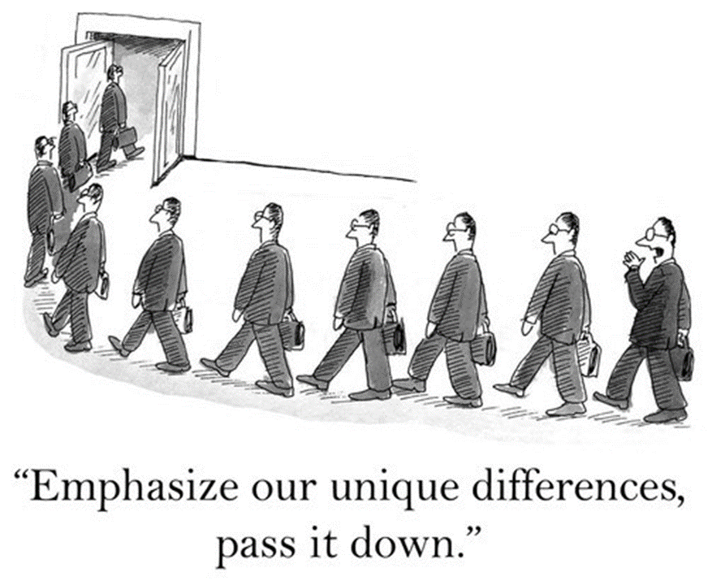

Slide 65
What can we do about it?
Training
Especially for decision makers, managers, those involved in recruitment and appraisal
Talk about bias; keep it on the agenda; stay vigilant
Take a Harvard “implicit association” test
https://implicit.harvard.edu/implicit/takeatest.html

Slide 66
What can we do about it?
Objectivity in decision-making
Use defined criteria and score-cards in eg, recruitment and appraisal
Require justification and evidence
Be wary of decisions based on “instinct” or “gut feel” or first impressions
Aim for diverse decision-making panels, to provide a range of perspectives and avoid “groupthink”
Avoid making decisions when we’re more vulnerable to bias:
For example when we’re tired, rushed, stressed, time-pressured or distracted

Slide 67
What can we do about it?
Incorporate bias “interrupters”, “nudges” and “primers” at key points in internal processes:
Remind people about the potential for bias and encourage them to be more objective
Give them positive role models
Use “observational bias” and “confirmation bias” in a positive way

Slide 68
What can we do about it?
Establish an inclusive culture, where people are encouraged to speak up and if appropriate to challenge the status quo
Let everyone, and every opinion, be heard
Call out stereotypes, generalisations, assumptions and other sloppy, ill-based thought processes
(Including our own)
Promote positive and stereotype-challenging role models, in our own organisation and beyond
(Check corporate literature)

Slide 69



Slide 70
What can we do about it?
Mix with our “out-groups”
Broaden our “in-groups”

Slide 71
What can we do about it?
Pay particular attention to the way we:
Recruit
Appraise
Allocate work
Build teams

Slide 72
Some practical steps for specific situations

Slide 73

Practical steps: Recruitment
Sift applications “blind” for relevant criteria:
Name (which can lead to assumptions based on gender and/or ethnicity)
Educational background (to increase social mobility)
Evidence that this makes a difference:
Blind auditions for orchestras
2009 DWP research on job applications, names and ethnicity

Slide 74
Practical steps: Recruitment
Assess applicants against objective criteria (eg competencies), using score-cards, and require selectors to justify their decisions accordingly
Have more than one person looking at each CV against the same criteria
Make selection panels as diverse as possible

Slide 75
Practical steps: Recruitment
Broaden where and how you advertise vacancies:
Which publications do you advertise in?
What images do you use?

Slide 76


Slide 77
Practical steps: Recruitment
Broaden where and how you advertise vacancies:
Which publications do you advertise in?
Avoid unduly restrictive images
Beware language that might put some people off
(eg unduly feminine, too elitist)
Limit the advert to the essential criteria

Slide 78
Practical steps: Recruitment
“Prime” (or “nudge”) decision-makers at critical points in the selection procedure
Remind them of the dangers of bias

Slide 79
Practical steps: Performance reviews
Take similar precautions with performance review and promotion processes and when setting targets
Make sure you have objective assessment criteria, and stick to them
Canvass views from several people

Slide 80
Practical steps: Performance reviews
Gather objective evidence (eg of success or failure rate, attendance record, etc)
to avoid “confirmation bias” or seeing patterns or clusters that don’t really exist

Slide 81
Practical steps: Work allocation & teams
Beware “ingroups” when allocating work
Mix things up a bit…

Slide 82
Practical steps: Work allocation & teams
Aim for “cognitive diversity” (ie different approaches, perspectives, working styles)
More diverse teams have been shown to be more productive
Different viewpoints help prevent groupthink and confirmation bias
Be creative about working patterns and approaches to a task

Slide 83
Other practical steps
See the IP Inclusive November 2017 toolkit
Best practices you can embed into your organisation’s systems and procedures to reduce the impact of unconscious bias

Slide 84
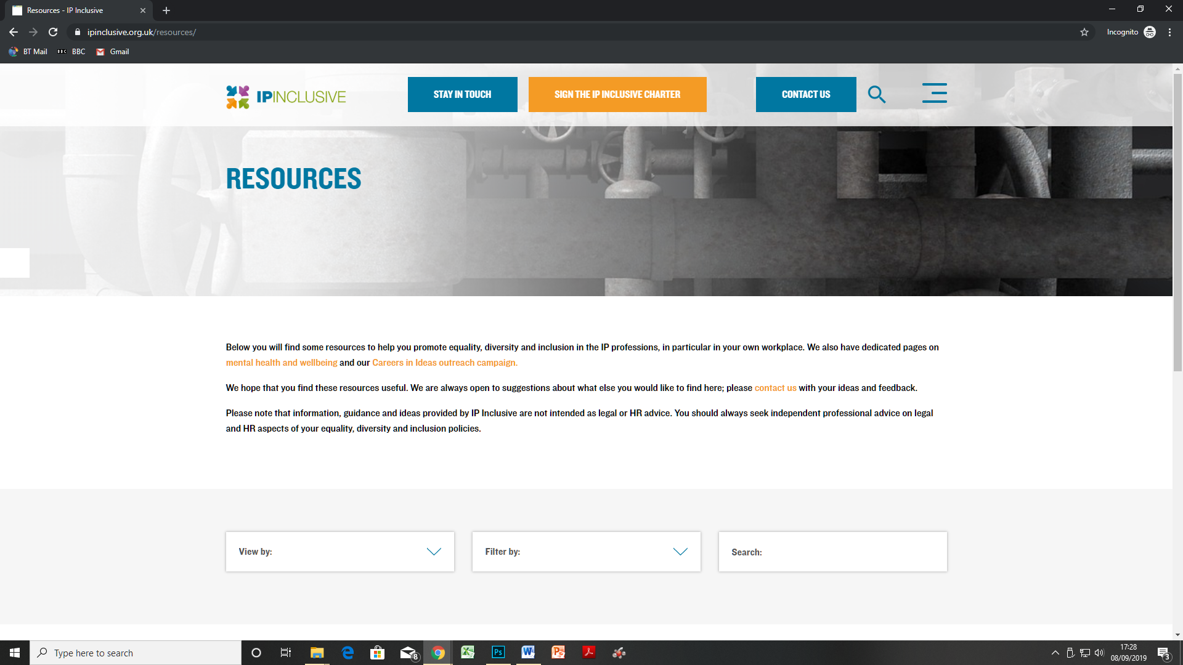

Slide 85
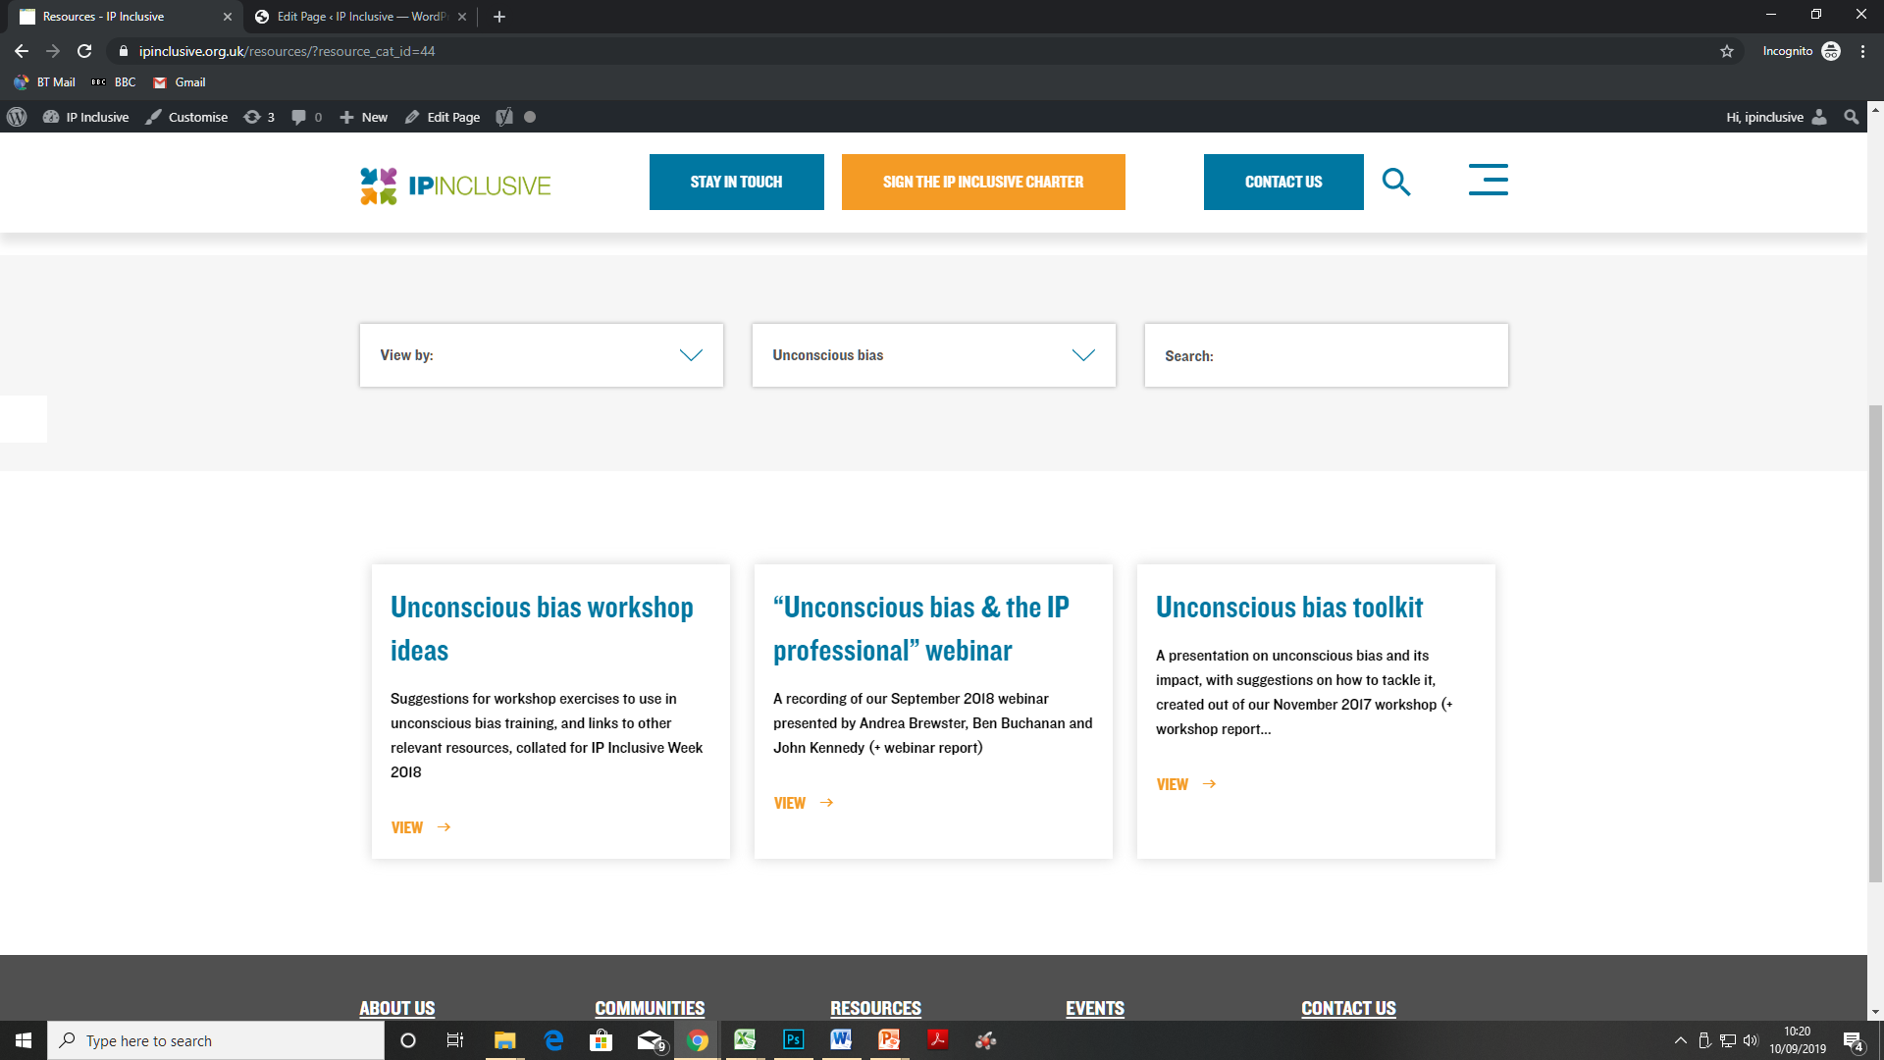

Slide 86
Summing up
Unconscious bias is all around us, in every decision we make
We apply it to people, roles, assessments, situations, data interpretation
It can have particularly detrimental impacts on work-related decisions around recruitment; staff appraisal and development; work allocation and team building

Slide 87
Summing up
It’s a natural thing; we shouldn’t beat ourselves up about it
But we must be aware of it and do what we can to reduce it

Slide 88
Summing up
Probably the most effective ways of tackling it are:
Training and awareness-raising
Making our decisions more objective and considered
Building bias “interrupters” and “nudges” into our systems and procedures
Creating an inclusive and open working culture

Slide 89
How to find out more
www.ipinclusive.org.uk
www.careersinideas.org.uk
contactipinclusive@gmail.com
@IPInclusive
@bameipinclusive
@IP_Ability
@ip_out
@WomeninIPI
@CareersInIdeas

Slide 90

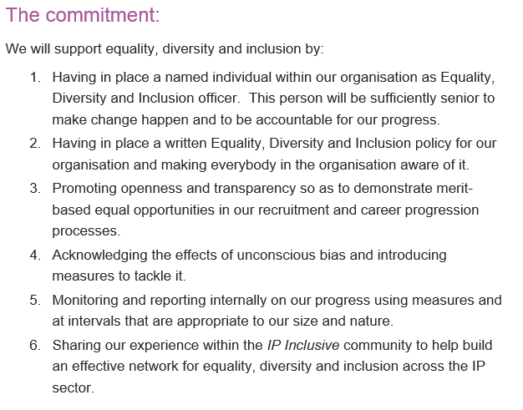

Slide 91
Thank you for listening! Any questions?
Working for
diversity and inclusion in IP

