Slide 1

Inclusivity and the menopause
26 February 2020

Slide 2
IP Inclusive
IP Ability
Women in IP
CIPA

Slide 3

Our speakers
Hannah Barton
HR Manager, Marks & Clerk
Karen Genuardi
Head of People, AA Thornton
Mandy Laurie
Partner and Head of Employment Division, Burness Paull
Chair:
Andrea Brewster
Lead Executive Officer, IP Inclusive

Slide 4
What we’ll cover
Some basic facts about the menopause
And its impact at work
Improving inclusivity
The legal and compliance aspects
Sources of help
Where to next?

Slide 5

Some basic facts about the menopause

Slide 6
What is menopause?
The menopause is when a woman’s oestrogen levels decline and periods cease – it marks the end of a woman’s reproductive life
The average age a woman reaches menopause in the UK is 51
Transition or ‘peri-menopause’ is the period that leads to the menopause, when many women experience symptoms
Around 1% of women experience menopause before the age of 40; 5% before the age of 45
The menopause can be brought on early by cancer treatment or surgery

Slide 7
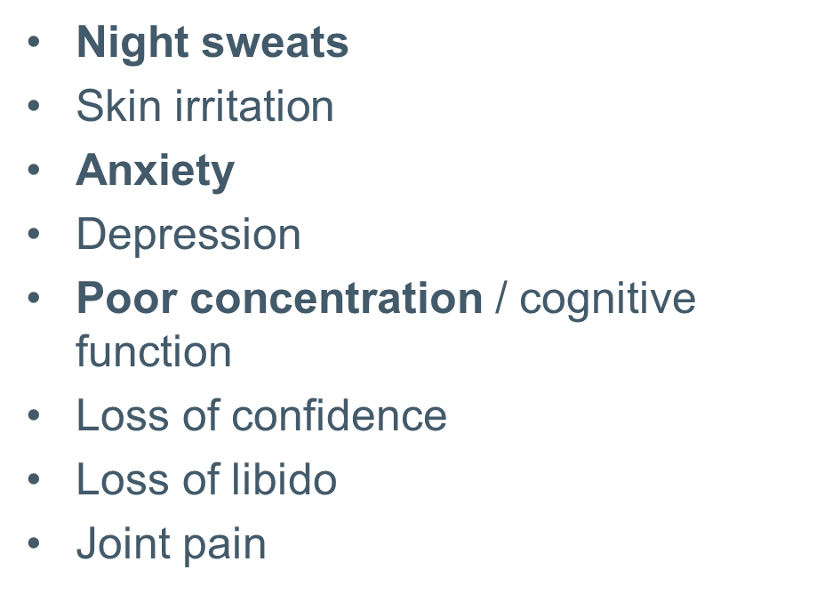
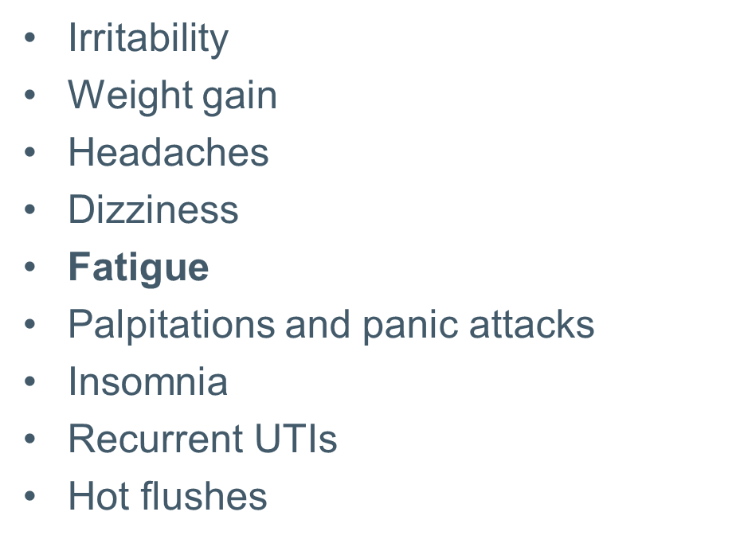
Typical symptoms
Everyone is different; symptoms can vary and fluctuate.
On average symptoms last for around 4 years, but 10% of women experience symptoms for up to 12 years.

Slide 8
Did you know…?
A survey for BBC news found that…
75% of women experience symptoms; 1 in 4 are serious
60% reported a negative impact at work
41% felt menopause affected their ability to do their job
70% didn’t tell their employer they were experiencing symptoms

Slide 9
Improving inclusivity

Slide 10
Legal and compliance

Slide 11
Sources of help

Slide 12
Sources of help
www.nhs.uk/conditions/menopause
www.womens-health-concern.org
https://thebms.org.uk
www.daisynetwork.org.uk
https://menopauseintheworkplace.co.uk
www.menopausecafe.net
www.talkingmenopause.co.uk
www.menopause-exchange.co.uk
www.menopausematters.co.uk
https://menopausesupport.co.uk
https://megsmenopause.com/menopause

Slide 13
Resources for employers & managers (i)
The Chartered Institute of Personnel and Development (CIPD):
https://www.cipd.co.uk/knowledge/culture/well-being/menopause/printable-resources
Downloadable guides, posters, leaflets
Do’s and don’ts for supporting your colleagues
Resources for HR teams and people line managers

Slide 14
Resources for employers & managers (ii)
NHS guidance on menopause
www.nhs.uk/conditions/menopause/
Women’s Health Concern (the patient arm of the British Menopause Society)
www.womens-health-concern.org
British Menopause Society
https://thebms.org.uk

Slide 15
Resources for employers & managers (iii)
Support for premature menopause
www.daisynetwork.org.uk
Faculty of Occupational Medicine
www.fom.ac.uk/health-at-work-2/information-foremployers/dealing-with-health-problems-in-the-workplace/advice-on-the-menopause

Slide 16
Resources for employers & managers (iv)
Henpicked, Menopause in the Workplace
https://menopauseintheworkplace.co.uk
Menopause Café – ‘gather to eat cake, drink tea and discuss menopause’
www.menopausecafe.net
Talking Menopause
www.talkingmenopause.co.uk
The Menopause Exchange
www.menopause-exchange.co.uk

Slide 17
Resources for employers & managers (v)
Menopause Matters
www.menopausematters.co.uk
Menopause Support
https://menopausesupport.co.uk/
Meg’s Menopause
https://megsmenopause.com/menopause/
The Health and Safety Executive Website (good resources, eg template for stress risk assessment)
https://www.hse.gov.uk/stress/standards/downloads.htm

Slide 18

Where to next..?

Slide 19

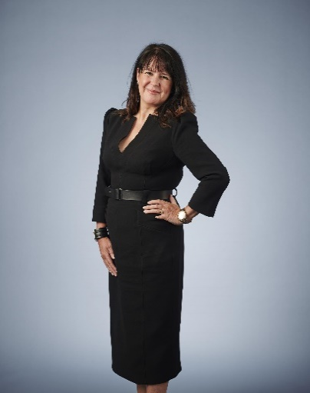
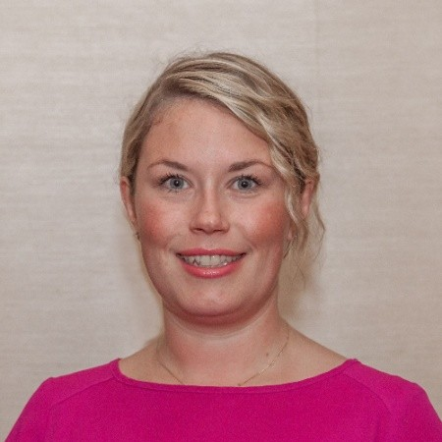
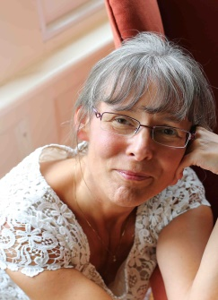
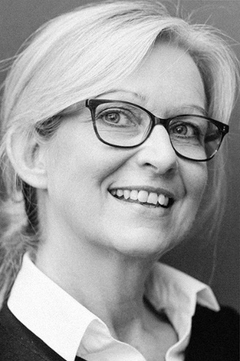
Mandy Laurie
Mandy Laurie
Hannah Barton
Panel discussion
Q&A
Andrea Brewster
Karen Genuardi

Slide 20
Thank you for listening!
Working for
diversity and inclusion in IP

Slide 21
IP Inclusive: How to find out more
www.ipinclusive.org.uk
www.careersinideas.org.uk
contactipinclusive@gmail.com
@IPInclusive
@bameipinclusive
@IP_Ability
@ip_out
@WomeninIPI
@CareersInIdeas

Slide 22

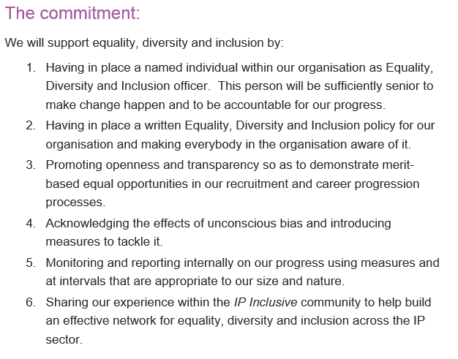

Slide 23
Biography: Hannah Barton
Hannah is a member of the Chartered Institute of Personnel & Development, and an HR Manager at Marks & Clerk. She works closely with leadership to deliver on people priorities and business objectives, and is a trusted advisor to eight Office Managing Partners and Office Managers. She has also provided training to group leaders on improving support for people who are going through the menopause.

Slide 24

Biography: Andrea Brewster OBE
Andrea is a Chartered Patent Attorney and European Patent Attorney. Until her retirement in 2015 she was a partner in the Somerset firm Greaves Brewster LLP, of which she had been a co-founder.
A former President of CIPA, Andrea is a member of the Institute’s governing Council and serves on several of its committees, including the Education Committee.
She is the founder and now Lead Executive Officer of IP Inclusive, an initiative that promotes diversity and inclusion (D&I) throughout the IP professions. She regularly speaks on D&I-related topics in the IP sector. In her spare time, she writes a light-hearted blog about her work: thenotsosecretdiary.weebly.com

Slide 25
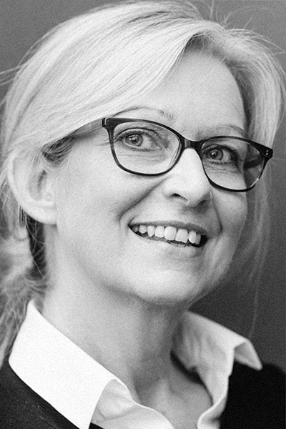
Biography: Karen Genuardi
Karen is the Head of People at AA Thornton. She has taken an active role in influencing and shaping the diversity and inclusion agenda at the firm since joining in 2013 and is also a member of the IP Ability Committee.
Karen’s HR career spans over 25 years across a range of sectors and roles, and she has supported many employees through a range of physical and mental health conditions and is keen to raise awareness about the impact of and the stigma often associated with menopause in the workplace.

Slide 26
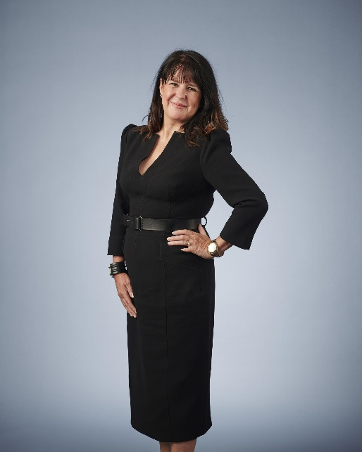
Biography: Mandy Laurie
Mandy is a Partner and Head of Employment Division at Burness Paull. She is also the Deputy Keeper of the Writers to the Signet. Her 2019 blog post on “The Menopause: The new protected characteristic?” caught IP Inclusive’s attention and we are delighted she agreed to join our IP panel.

