Slide 1


Work Experience Day Presentation
Date

Slide 2
WELCOME!
Who we are…
We are a firm of patent attorneys, trade mark attorneys and solicitors…
…and also accountants, secretaries, information technology, human resources and business development experts
We all work in the field of Intellectual Property (IP)
Notes:
In the first instance, it’s worth spending a couple of minutes explaining who the firm are, providing a brief itinerary of the day, and the usual housekeeping such as fire escapes, toilet location etc. you can then introduce the various careers of people who work in your office

Slide 3
Intellectual Property
What is it?
We all have ideas
Sometimes people will pay you for them.
That’s intellectual property!
What does this mean in practice?
Notes:
This introduction is taken from the Careers in Ideas Website, which is worth pointing the students towards at the end.

Slide 4
Patents
Trade Secrets
Trade Marks
IP
Copyright
Designs
Notes:
This is a useful graphic to introduce the students to the main types of IP they may encounter. Don’t spend too long on this slide, just introduce the terms.

Slide 5

Recognise this?
Notes:
Coca-Cola is a good example to use for this presentation because it has plenty of brand recognition, as well as plenty of different examples of IP to discuss. You can launch straight into the presentation, and see if people recognise the branding or TM. This example of the Coca-Cola brand is from China.

Slide 6

Or this?
Notes:
More students may recognise this, which is from Ethiopia.

Slide 7

What about this?
Notes:
This is the Arabic version of the logo,

Slide 8

It’s Coca-Cola!

Slide 9
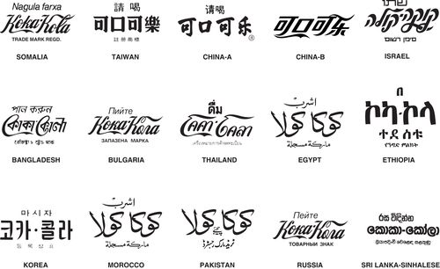
Notes:
This slide brings together the similarities in the brand, despite the different languages.

Slide 10
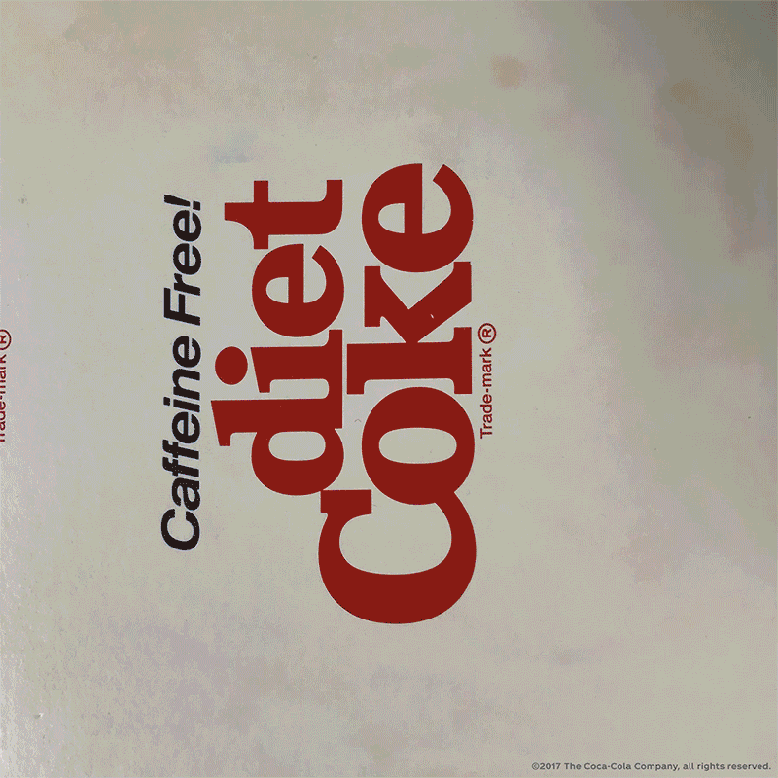
Even with multiple variations, the brand is consistent

Slide 11

Protecting Brands
Brands can normally be protected with a trade mark registration
Trade marks are a badge of origin
They are normally words or a logo
They are registered in respect of goods and/or services
The first Coca-Cola registration in was in the US, filed in 1892 for soft drinks
Notes:
At this stage you can introduce the students to the IP types mentioned above, but in a bit more detail. Feel free to expand on the slides, but keep it simple.

Slide 12
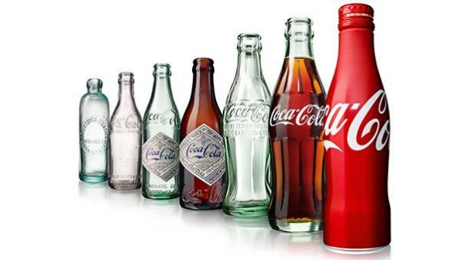
Protecting Designs
The shape of products can also be protected, and can be just as an important part of the brand as the name or logo
Notes:
Highlight the differences in the shape of the bottles, the applied colours, the labels etc.

Slide 13
Protecting original works
Images, music and written work in particular may not be protectable by registered designs and trade marks
They are protected instead by copyright ©
Which means the copyright owner has the right to prevent unauthorised copying
Coca-Cola artwork, written works, advertising imagery and jingles will be protected by copyright

Slide 14
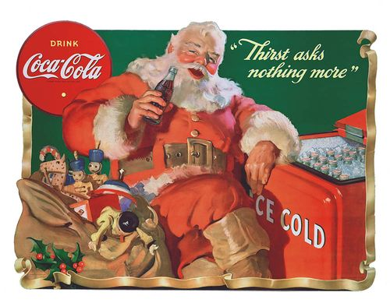
Even Father Christmas!
Notes:
This is actually an urban myth. Santa had been wearing red for many years before Coca cola started using his mage, though they did use it consistently since the 1930s

Slide 15
Patents
Patents protect technical inventions such as new products or methods
They can normally last up to 20 years from filing
Detailed information about the invention is put into the public domain
Coca-Cola company have 1000s of patents covering many inventions including:
Beverage dispensers
Refrigeration units
Methods of manufacturing improved bottles
Sports drinks
Protein shakes

Slide 16
What about the Coca-Cola Recipe!
That’s a trade secret
Other examples include the Google Search algorithm
The Colonel’s KFC recipe
Listerine mouthwash

Slide 17
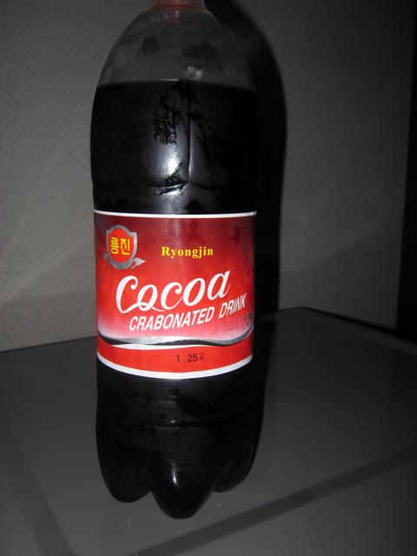
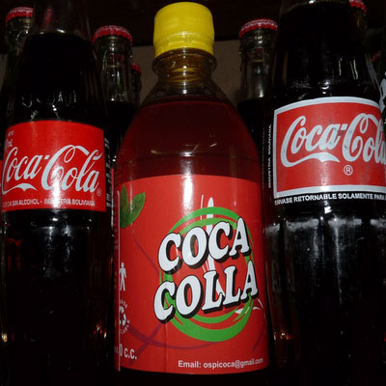
Why you need to protect!
Notes:
A student at the last talk asked how the image on the left could infringe, bearing in mind it is spelled differently to Coca-Cola and has a different design, so be prepared for some good questions.

Slide 18
Now you know all about IP…
You are going to be split into four groups,
Each group will be shown a product, or a series of products
And you will investigate the different types of intellectual property that could apply…
…which you will then present to the other groups
We will then talk to you about what we do and the careers in IP
Lunch!
Tour round the office
Notes:
This reiterates the itinerary in more detail, and lets the students know what they will be doing. Some may not like the idea of doing a presentation, so reassure them that it will be fine. The itinerary can of course be adapted to suit whatever suits you,

Slide 19
Types of IP
Copyright © - this protects original work such as pictures, music and writing
Trade Marks ^{TM/®} - these protect brands names and logos
Patents – these protect inventions
Designs – these protect the way something looks
Trade Secrets – People can’t copy it if they don’t know what it is!
Notes:
At this point you split the room into group, if this hasn’t happened passively already. This is a useful slide to leave up after the presentation so that the students can refer to it while working.

Slide 20

Further Information

