Slide 1
IPO resources for universities
Lisa Redman and Jenny Vaughan innovation@ipo.gov.uk

Slide 2
We want everyone to understand that IP matters
Notes:
The IPO’s corporate objectives, what, why and how….

Slide 3
IP Support Platform
https://www.ipo.gov.uk/ip-support/
Notes:
Introduction to our tools and resources – IP Tutor, IP Tutor Plus and IP for Research – detailing the messages, pitch, methods of delivery and messaging impact. Hints and tips to how they have been used by academia and IP professionals to raise awareness of IP and encourage an understanding of potential careers in IP.

Slide 4
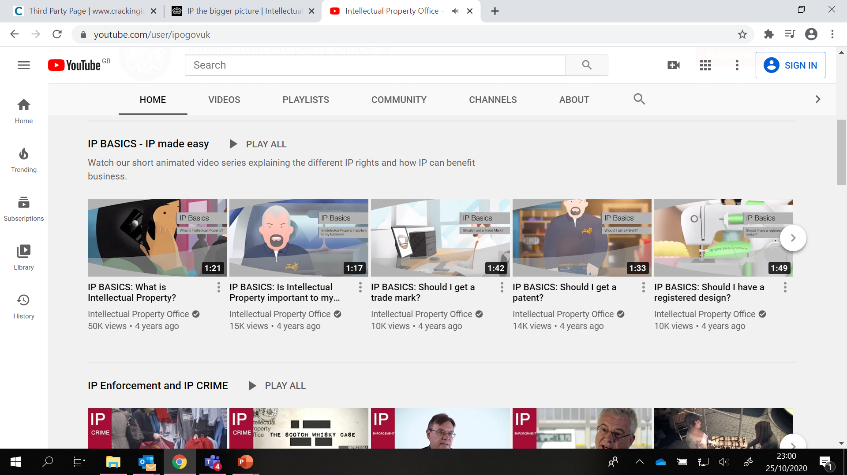
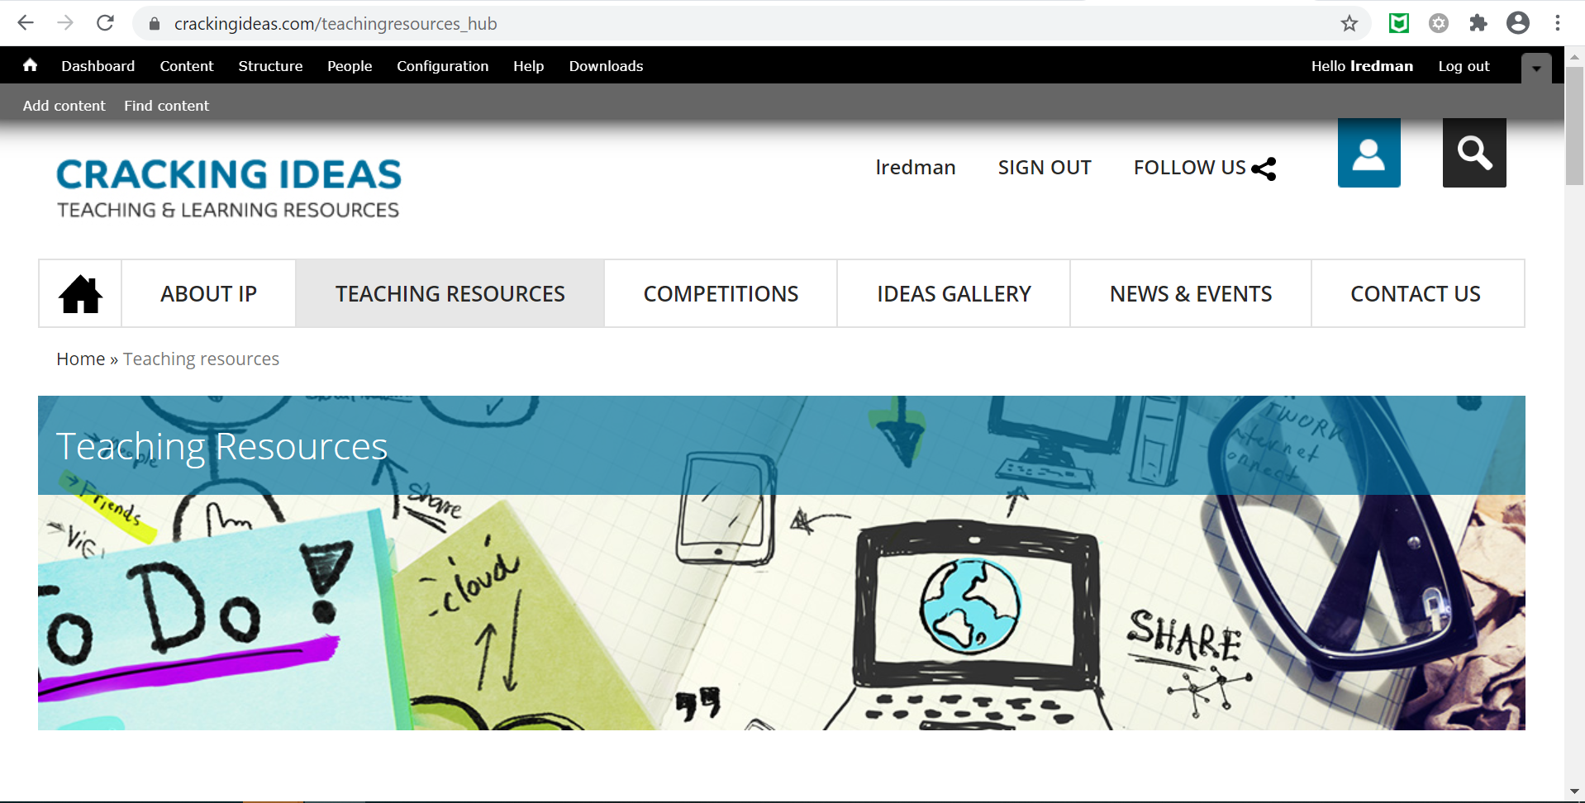
Crackingideas.com
IPO YouTube Channel
www.youtube.com/user/ipogovuk
Notes:
Other resources that have been used to raise awareness of IP within universities.

Slide 5
Crackingideas.com
Notes:
Illustration of Cracking Ideas resources

Slide 6
3 key points
1. Remember audience, language and tailoring
2. Use everyday examples to bring to life
3. Keep it short/bitesize chunks
Notes:
Summary of hints and tips to engage, encourage and enthuse students to potentially seek a career in IP.

