Slide 1
Summer of IP and Careers in Ideas – an introduction
Andrea Brewster OBE (she/her)
Lead Executive Officer, IP Inclusive
June 2023

Slide 2
What we’ll cover
What Careers in Ideas is and what it does
Why it’s organising Summer of IP
How Summer of IP works, what’s in store and how you can get the most out of it
Including some basic formal stuff about who’s in charge and what you can expect of them

Slide 3
Careers in Ideas
The outreach arm of IP Inclusive
Raising awareness of IP-related careers
Improving access
Diversifying the pool that the IP professions recruit from

Slide 4
What we do
Information, events and resources for students and their advisers
Resources to support IP professionals’ careers outreach activities

Slide 5
What we do
Website:
https://careersinideas.org.uk/

Slide 6
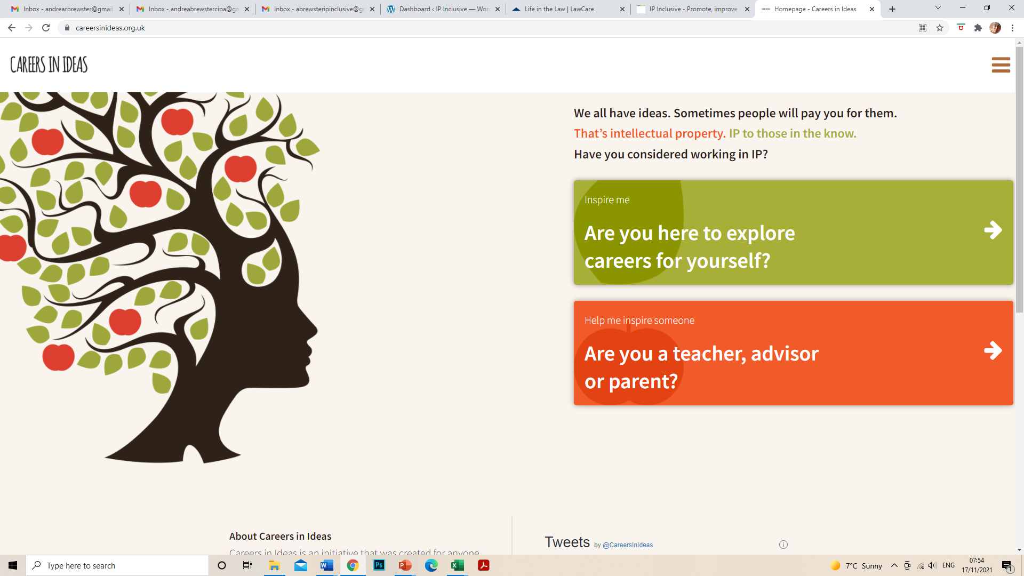

Slide 7
Website
Information, news, events, resources
Showcases all sorts of IP-related careers:
Basic information, eg about job description, entry requirements and essential skills, prospects
“My Career in Ideas” personal stories

Slide 8
Relationships
Building relationships with relevant charities and community interest groups
To help us reach the recruits who most need our information and support
Also with schools, colleges and universities
Working with IP sector organisations to improve access and fair recruitment

Slide 9
Our remit
For all IP sector careers (including “business support”)
For all diversity strands, not just eg gender balance or social mobility

Slide 10
How we’re run
Run by a “task force” of IP professionals from a range of roles, career levels and professional backgrounds
All volunteers

Slide 11
Social media
LinkedIn: Careers in Ideas
Twitter: @CareersinIdeas
Instagram: careersinideas

Slide 12
About Summer of IP
A series of events and activities through the summer of 2023
Raising awareness of IP sector careers
Pre-application opportunities for a wider range of potential recruits

Slide 13
About Summer of IP
https://ipinclusive.org.uk/careers-in-ideas/summer-of-ip-2023/
– information about all the various activities and events on offer

Slide 14
Summer of IP: What’s in it for you?
Knowledge:
What IP is, how the IP professions work, the careers available here and which might be right for you
How to get into the ones that interest you, and the skills required
Experience:
Of the working environment and the people who already have IP careers
New contacts:
In the IP professions, and also among other people who are considering joining
Something to put in your CV/personal statement/covering letter
Notes:
Not constantly worrying about keeping aspects of themselves hidden. If you’re worrying about people finding out you’re gay, or that you’ve suffered from depression; if you’re working extra hard to prove yourself because you’re the only woman or the only person of colour and people are viewing you with suspicion, how can you perform at your best?

Slide 15
Summer of IP: What’s in it for us?
Raising awareness:
IP is a niche area which some people never get to hear of, or certainly too late for it to affect their career choices; we want to share what we’ve found here
Attracting a wider range of people:
Especially from currently under-represented groups
More diverse teams perform better
It’s the right thing to do!
Notes:
Not constantly worrying about keeping aspects of themselves hidden. If you’re worrying about people finding out you’re gay, or that you’ve suffered from depression; if you’re working extra hard to prove yourself because you’re the only woman or the only person of colour and people are viewing you with suspicion, how can you perform at your best?

Slide 16
How it works
Two parts:
General introductory events and resources from Careers in Ideas
Opportunities from individual IP sector employers
Learning about the various careers in IP and also gaining practical experience of an IP workplace

Slide 17
Introductory events
Ideally, watch/attend these before you take part in any Summer of IP employer activity
The first few give background info, eg what IP is, the different types of IP and the types of career you can build here
Some broadcast live during July 2023; others pre-recorded
Recordings (and slides if appropriate) available afterwards

Slide 18
Introductory events
Several events and recordings focus on particular roles or working environments:
What to expect in certain roles, the types of people they suit, different routes in, what people enjoy about them
Some will give you a chance to talk to people who are already in IP careers
Some will give you tips about how to apply for a particular type of job

Slide 19
Employer activities
Free activities and events from individual IP sector employers
Eg informal drop-in chat sessions, “taster” days, work experience
Give you a better feel for what it’s like to work in IP
More details on the Summer of IP webpage
Apply directly to the organiser of the activity
Hurry: places are limited and there are application deadlines to meet!

Slide 20
Keeping records
Make a note of everything you attend or take part in
Put it in your CV, personal statement or covering letter
If you later apply for an IP career, it will show you’ve made the effort to find out about the sector and what the work entails
Good talking point for interviews

Slide 21
Introductory events: more info
Full details via the Summer of IP webpage
Registration links for live events
Recording links when available
Intended for secondary school and university students, graduates, career changers: in fact, anyone interested in careers in IP
All free of charge

Slide 22
Introductory events: more info
Please ask if you have specific access requirements; we'll do what we can to help
Email ipinclusiveevents@gmail.com

Slide 23
Employer activities: more info
Run by individual participating organisations
(all IP sector recruiters)
They decide the details: type of activity/event; where; when; who it’s suitable for
They’re responsible for complying with relevant legislation and appropriate safeguards

Slide 24
Employer activities: more info
Employers must comply with our Summer of IP guidelines
They will treat you fairly, considerately and respectfully

Slide 25
Employer activities: more info
Employers can set their own – reasonable – criteria for selecting people to take part in their activity, but they must have an objective and non-discriminatory recruitment process
Including reasonable adjustment policies to support people who have a condition, impairment or disability
Most will give priority to people from groups that are currently under-represented in the relevant IP careers
eg people from less privileged backgrounds, females in STEM, people with minority ethnic backgrounds, or disabled or neurodivergent people

Slide 26
Employer activities: more info
All activity providers are committed to improving equality, diversity and inclusion in the UK IP professions
They are IP Inclusive supporters and partners, and/or signatories to the IP Inclusive EDI Charter
Many have one or more individuals in their organisation who have signed our Senior Leaders’ Pledge

Slide 27
Employer activities: more info
If you have any problems or concerns about a Summer of IP activity, please contact the activity provider directly
There’s information about how to do that in the summary of each activity

Slide 28
After Summer of IP: what next?
We hope you’ll have found the ideal IP career for you
For help getting your first job, sign up to our Careers in Ideas Mentoring Hub
Find out more about different IP sector careers, and keep an eye on future opportunities, through the Careers in Ideas website
Follow Careers in Ideas on social media (details in earlier slide)

Slide 29
Any queries?
Please email me at contactipinclusive@gmail.com
Include “Summer of IP” in the subject line

Slide 30
Thank you for listening!

