Slide 1
Careers in Intellectual Property

Slide 2
Agenda
What is Intellectual Property? A recap…
Careers in creation… and careers in protection!
Skills to pay the bills
Roles in IP
Get in touch

Slide 3
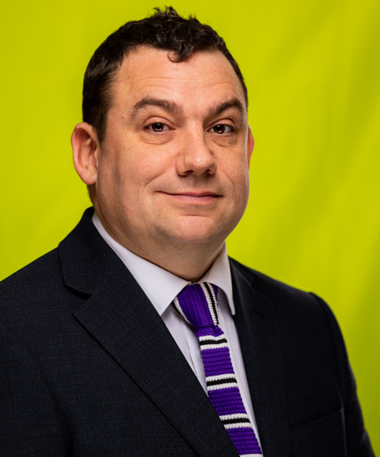
Introduction
Chris Burnett
Senior Associate,
Chartered Patent Attorney and European Patent Attorney
Intellectual Property team,
Birkett Long LLP

Slide 4
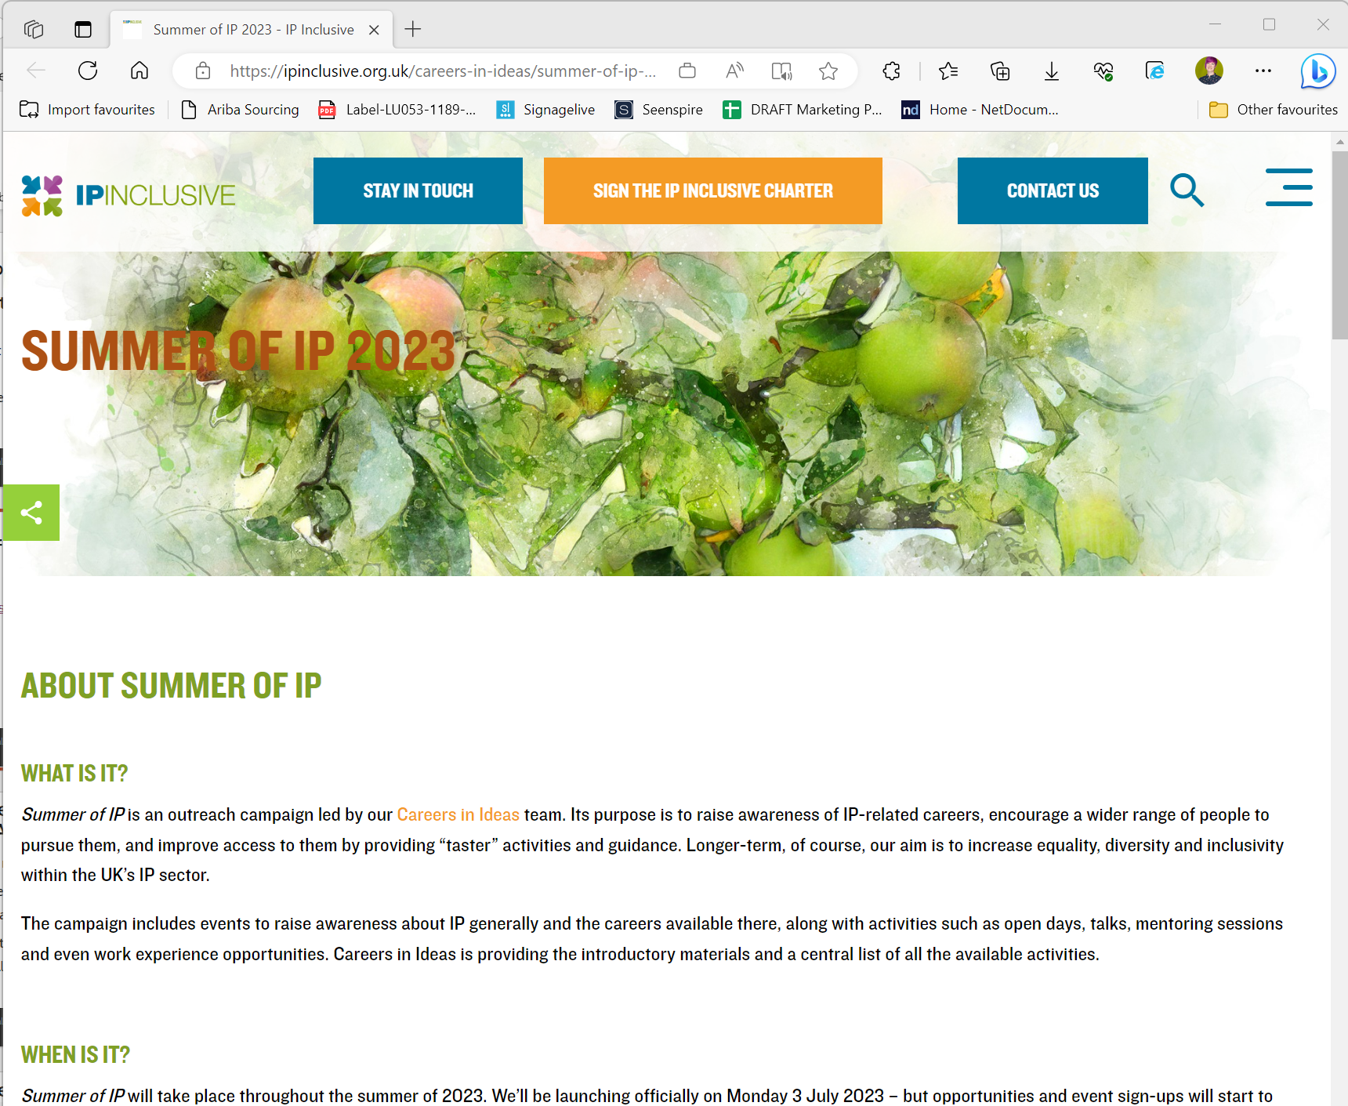
Summer of IP
https://ipinclusive.org.uk/careers-in-ideas/summer-of-ip-2023/

Slide 5

What is Intellectual Property? A recap…
“Creations of the mind”
Intellectual property rights (IPRs) protect these creations of the mind
Copyright protects works such as literary or musical works and computer programs ©

Slide 6

What is Intellectual Property? A recap…
Patents protect inventions, such as new products and processes
Trade marks protect brands ®
Designs protect the shape and configuration of products

Slide 7

Careers in creation…and careers in protection!
These roles require a whole range of skills, knowledge and interests
Summer of IP will go into more detail about many of the roles
See also https://careersinideas.org.uk/ and careers booklet for more information

Slide 8
Product design
Creating a new shoe
Brainstorming
New Invention
Patent Attorney
Patent Analysts
Patent Examiner

Slide 9

Skills to pay the bills
Careers in patents normally require a STEM (Science, Technology, Engineering and Mathematics) degree

Slide 10
Skills to pay the bills
To be a good patent attorney, analyst or examiner, you will need: - a good analytical mind - be good at solving puzzles - be good at communicating ideas

Slide 11

Follow up Inventions and Innovations
There may be further improvements to the technology
The patent attorney will be kept in touch in case of new inventions

Slide 12

Branding
It is possible to protect a brand name with a registered trade mark
A registered trade mark will have an ® symbol
Registered trade marks have been examined

Slide 13

Trade mark attorneys
Trade mark attorneys file trade mark applications
They providepre-filing advice
They can also manage the trade mark rights once they are registered

Slide 14
Trade mark attorneys
To become a trade mark attorney you will need a degree (does not need to be a particular subject)

Slide 15
Trade mark attorneys
The main skills for being a good trade mark attorney are having an analytical mind and great communication skills
Trade mark law is very fast moving

Slide 16

Trade mark examiner
The UK Intellectual Property Office examines trade mark applications
Trade mark examiners do not require a degree – so may suit people who do not wish to go to University
Requires a very good analytical mind and good use of language

Slide 17
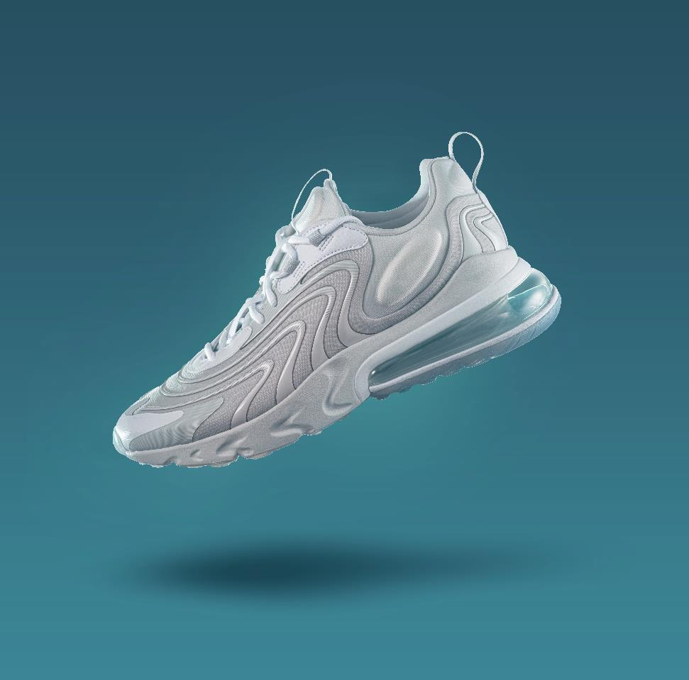
Designs
The shape of the sole and the whole trainer itself can be protected with a registered design
These must be new and have individual character

Slide 18
Designs
Design registrations are also granted by the UK Intellectual Property Office
Filed by patent or trade mark attorneys

Slide 19

Enforcement of rights
Competitors will assess the new sole
They can copy or design around it
What roles are there for Intellectual Property professionals from here?

Slide 20

Patent attorneys
Patent attorneys for the competitors will study any published patent
Is the patent granted?
Can the patent/patent application be attacked?

Slide 21
Patent attorneys
If there is no patent, it will be a lot easier to copy!
Can the rights be defended?

Slide 22

Intellectual Property (IP) solicitors
The roles of IP solicitors may overlap with patent and trade mark attorneys
IP solicitors may have a technical background
A good business mind

Slide 23
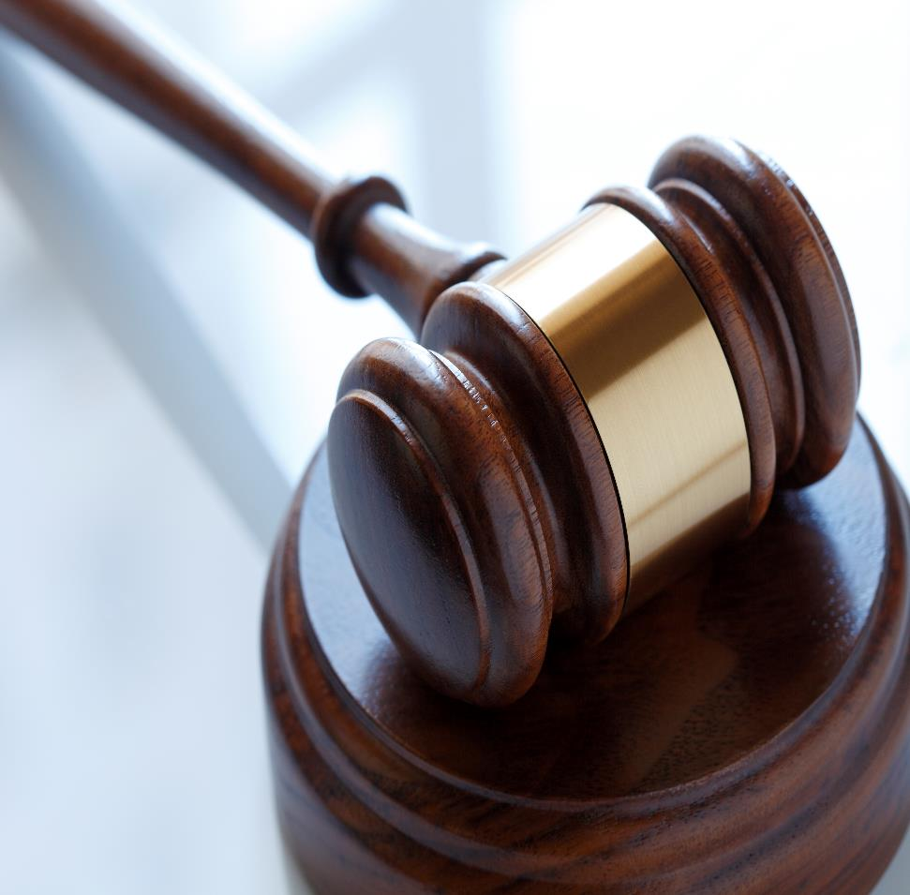
Intellectual Property Barristers
To court! A competitor has made a shoe with a very similar sole
Barristers specialise in representing clients in litigious matters

Slide 24
Intellectual Property Barristers
Barristers will often work alongside solicitors and patent and trade mark attorneys on litigation matters
Barristers will need similar strong analytical skills as attorneys and solicitors

Slide 25

Finance
Insurance roles
Intellectual Property backed lending
Mergers and acquisitions
Intellectual Property valuation

Slide 26

Administrative/ Support roles
Many essential and rewarding support roles do not require a technical background or a degree
A lot of Intellectual Property work is transactional

Slide 27
Administrative/ Support roles
Roles and job titles will depend on the firm and the level of responsibility
High levels of organisational skills and attention to detail

Slide 28
Get in touch…
Chris Burnett
https://careersinideas.org.uk/contact-us/
chriscareersinidea@gmail.com

Slide 29
Thank you

