Slide 1
Shining a Light On Menopause
Trainer:
Jonathan’s Voice
www.jonathansvoice.org.uk
Registered Charity 1180424

Slide 2
World Menopause Day 2023
In this webinar, we’ll learn more about the menopause and perimenopause, hear from a panel of IP professionals about their personal experiences and suggestions, and have the chance to share our own thoughts and experiences in small breakout groups
Notes:
*** Whilst this webinar refers to ‘women’ it is important to recognise that not everyone that is affected by menopause is a woman. This can impact our non-binary and trans colleagues too. ***

Slide 3
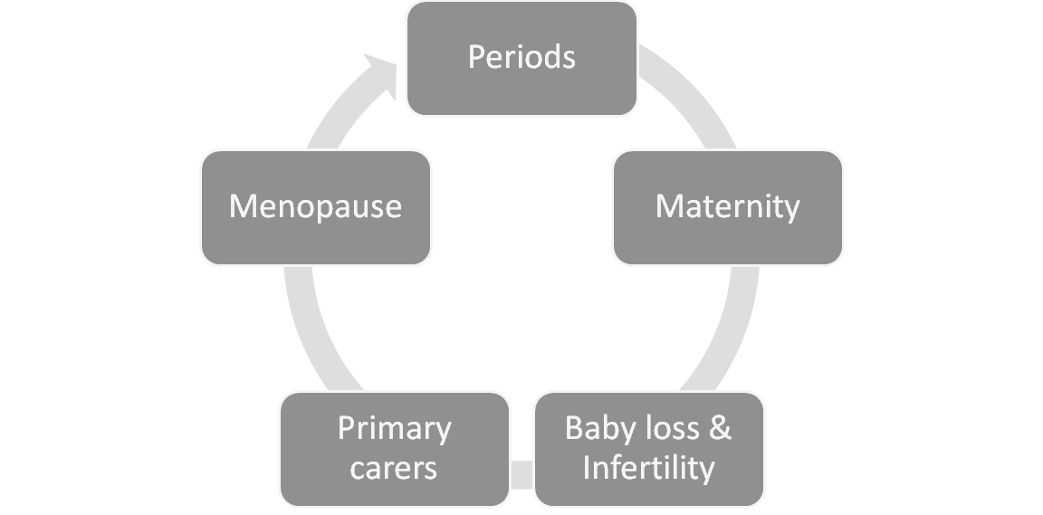
Employee lifecycle
Menopause is a normal and natural transition in the reproduction cycle
Notes:
All employees navigate many different phases in their personal life alongside the employee lifecycle. Each is interconnected and may call upon adjustments and adaptations at work and at home. For women (or those with female reproductive organs), this may include managing symptoms or challenges associated with anything from menstruation to menopause – all natural processes impacting a huge number of people in the workplace and yet these subjects have been taboo, dismissed, stigmatized or seen as a weakness! Menopause may also impact personal relationships with mood swings and low libido for example.
Worth noting that all genders can experience challenging times including hormone imbalance. For example, men can experience a drop in testosterone known as ‘andropause’ or we hear reference of a ‘mid-life crisis’ which to may need reasonable adjustments and support – Men should be encouraged to speak up about physical and mental ill too.

Slide 4
4 stages of menopause
Pre-menopause: Regular menstrual cycle, prime childbearing years
Perimenopause (Average 45-52, for 5-7 years) Estrogen declines, unpredictable periods, hormonal shift causes hot flushes, dry skin, brain fog, aching joints, low libido etc.
Menopause (Average UK age is 51) End of natural transition. Menstrual cycle stopped for 12 months. Hot flushes, increased heart rate, disturbed sleep, physical changes, low mood, etc.
Post Menopause: Refers to stage after menopause and lasts remainder of life. Due to decreased estrogen, increased risk of osteoporosis and heart disease
Notes:
Menopause is a natural transition but despite this, many people still find it is met with bias and lack of empathy, making it a really difficult and lonely time. Add to this the onset of symptoms as we go through the stages of menopause, and it can lead to misery in the workplace and in the home.
There are 4 stages to menopause. Perimenopause usually begins mid 40’s & lasts several years before periods finally stop. The average age for menopause (periods have stopped for 12 months) is 51 but symptoms will continue for several more years. Symptoms may include poor concentration/memory, tiredness and sleep deprivation, low mood/anxiety, hot flushes/sweats, aching joints and this can result in lowered confidence – lasting years! There are long term health implications linking menopause to cardiovascular disease and osteroporosis.
The onset of, and ongoing symptoms vary and may not always be recognised as menopause and can be a really worrying time.

Slide 5
The workplace issues
Discrimination and bias
Performance issues
Lack of psychological safety
Managers lack training
Lack of support or reasonable adjustments
Environmental challenges
Notes:
Add to this that some people may be at the peak of their careers, but menopause may not only cause physical and mental health challenges but brings about new discrimination or bias.
Individuals may find themselves under work performance reviews when there are changes in the way they work. Perhaps an employee does not feel comfortable speaking to a manager about the impact of menopause or a manager simply does not know how to support an employee.
It is reported only 1 in 10 people ask for adjustments in the workplace such as flexible working or adjustments to working environments.
Dealing with body changes and struggling perhaps with concentration at work can leave someone feeling very vulnerable

Slide 6
Supporting employees
Awareness and resources
Training for managers and employees
Menopause /flexible working/reasonable adjustment policies
Health benefits and wellbeing initiatives
Employee networks
Equality Act 2010
Notes:
But, the good news is, at long last we are starting to take menopause seriously, raising awareness of the impact it can have and understanding how much difference the right kind of support and treatment can make. We have made progress in education and access to resources. Some employers have launched menopause policies, but the challenge remains in embedding those so people feel genuinely supported and listened too. There is a need to empower people so they can make informed decisions on managing their own menopause in a way that works for them and to reduce the associated health risks.
Organisations need to take action - People at menopausal age have lots of experience and skill so failure to fully support them can result in talented people leaving the business. Employers need to make reasonable adjustments, allow greater flexibility and support employees through this transition. The conversation needs to change to gender equity in the workplace.
There is also not a legal implication. Menopause is most certainly covered by the Equality Act 2010 under sex, ageand disability discrimination. We are beginning to see women go to tribunal and win discrimination cases so at the very least, employers have a legal obligation to get this right.

Slide 7
Shining a light on menopause
Notes:
One thing is for sure, women play an important part in any business. The female lifecycle is not a barrier but a normal part of who they are and as such workplace policies, practices and support functions should be inclusive in acknowledgement of reproductive, menstrual, and menopausal health issues.
Lets handover to Penny

