Slide 1
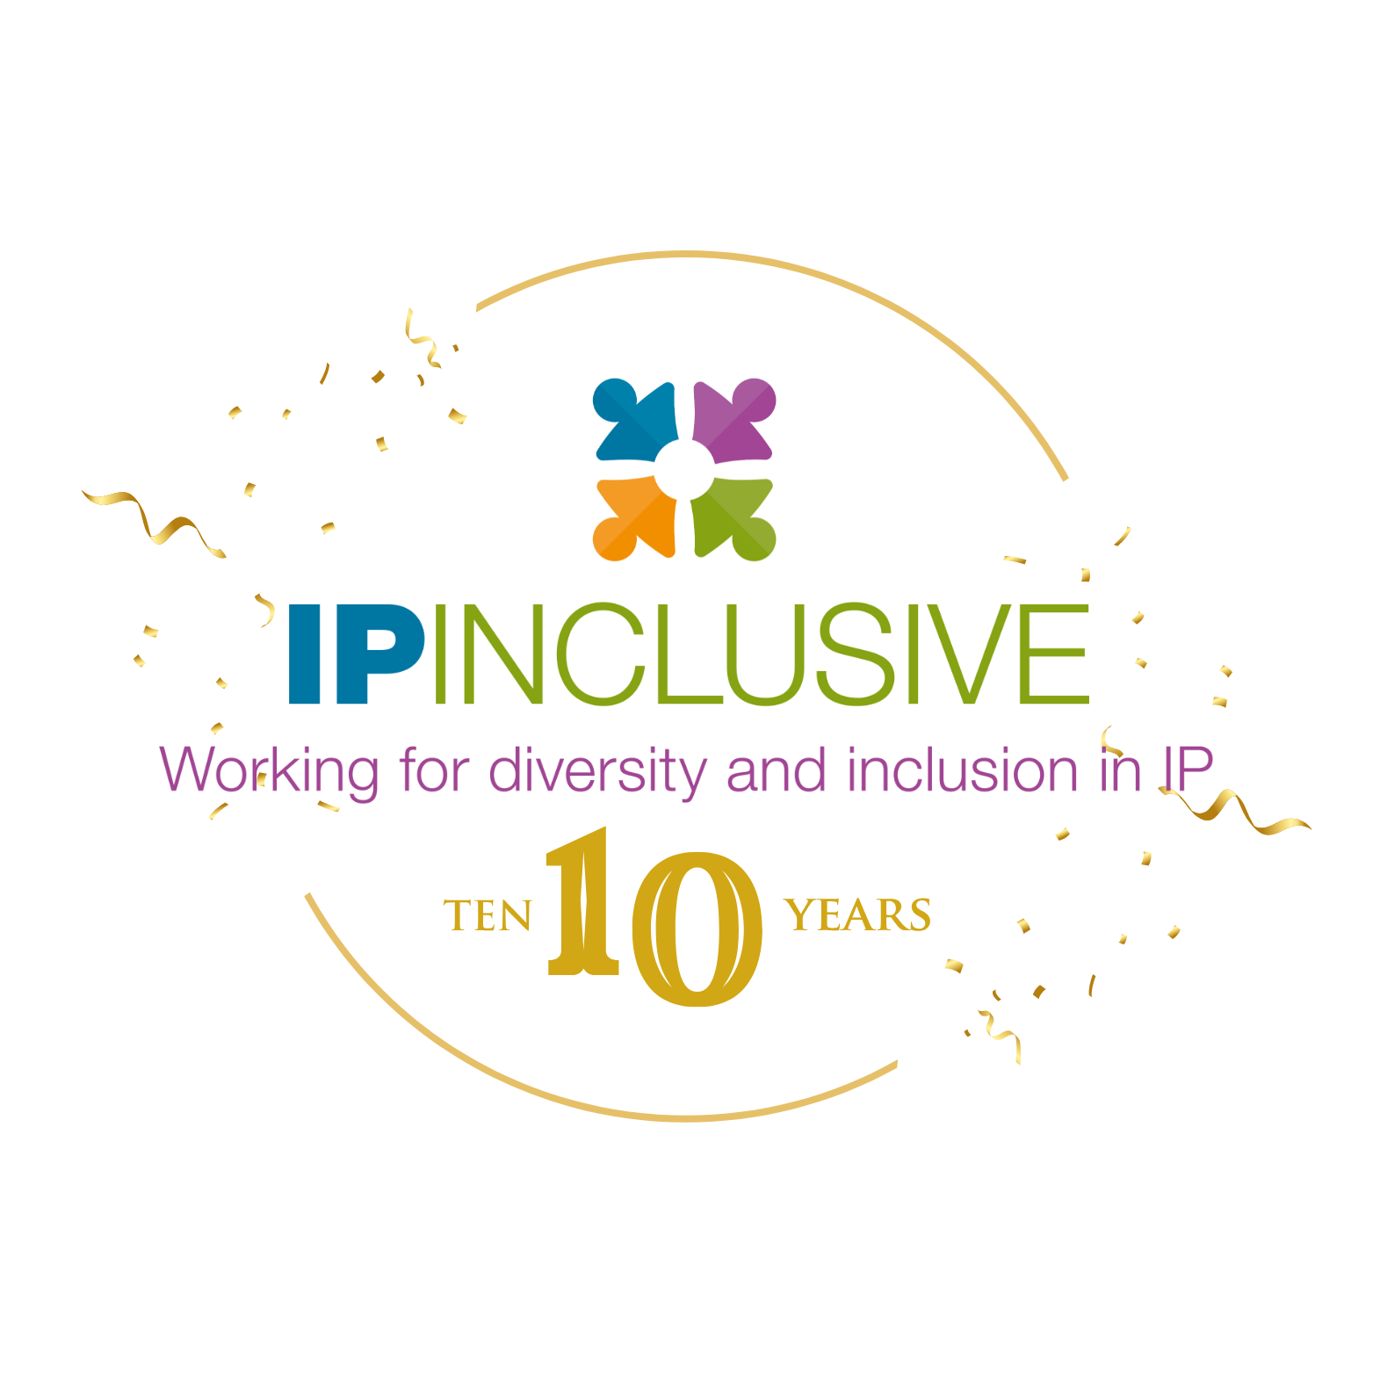
IP INCLUSIVE IMPACT REPORT 2025
A sneak preview…

Slide 2
Impact on EDI in UK’s IP sector
Three quarters of all respondents agree or strongly agree that IP Inclusive has had a positive impact within the UK’s IP sector on EDI and wellbeing

Slide 3
Impact on individual IP professionals
>77 % of individual respondents agree or strongly agree that they personally value and/or have been impacted by IP Inclusive’s work on EDI and wellbeing.

Slide 4
Why we value IP Inclusive
Why we value IP Inclusive
Education
Sharing best practices
Sense of community
Making EDI relevant
Facilitating conversations
IMPACT
Advice

Slide 5
Making a Difference to Individuals
“IP Inclusive has created communities for people to find others with similar values, find support, and find best practice. I would struggle if IP Inclusive was not around.”
“It has enabled me to get back to work.”
“I've joined Mentorloop and have mentored several mentees.”
“It has opened up my circle of safe space in the profession - people like me and who want to talk about DEI.”
“It has opened my eyes to wider ideas.”
“It has given me confidence to be more vocal about EDI.”
“Having a flagship organisation open to discussing queer and feminist topics is amazing. Knowing that events exist and that my colleagues are attending helps me feel less ‘othered’.”
“It made me feel more comfortable joining a legal profession. Being aware that there was a conversation happening about inclusivity and empathy, and an organisation trying to improve things, was very reassuring.”

Slide 6
Making a Difference to Charter Signatory Organisations
“The events that IP Inclusive hold are incredibly valuable for keeping us up to date and educated.”
“The events are now one of the best options for general networking with other IP professionals.”
“The absence of such a dedicated initiative would mean fewer resources, less collaboration across the sector, and potentially a lack of accountability in driving meaningful change.”
“It has helped empower individuals to engage in and advocate for EDI initiatives, knowing that our commitment is embedded in our values and practices.”
“Without an industry wide galvanising initiative, it would not be as powerful a message in our communication to businesses, clients, partners, and future employees around the world”
“It has encouraged us to address topics that would previously have been considered inappropriate to talk about and has allowed us to demonstrate that we value members of the firm as people and as individuals.”
“We hosted an event as part of the Summer of IP last year and this was really impactful - lots of people were involved and it was such a positive day.”
“It has helped me reflect on how important it is for everyone to feel they belong. People who belong feel free and motivated to contribute and this has obvious benefits for the business.”

Slide 7
Making a Difference to the UK’s IP Profession
“IP Inclusive is the only organisation enhancing the sense of community and the values of respect and openness amongst IP professionals. It brings together IP professionals sharing these values and supports underrepresented groups - I think it is vital for it to continue. “
“IP Inclusive provides an organised voice and place for like-minded IP practitioners to take collective action.”
“It has made me feel supported in my role as EDI Partner at my firm, with a sense of the community and profession as a whole working together towards a common goal rather than individuals trying to make a difference on their own.”
“I am glad the Careers in Ideas programme exists to open doors to the future generation, it is also absolutely vital.”
“IP Inclusive sets a standard and encourages everyone to improve. Without it, I consider that the profession would be worse off.”

