Slide 1


IP Inclusive 2025 Impact Report
June 2025

Slide 2
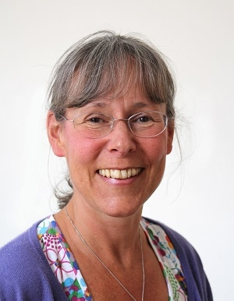

TEN YEARS, TEN IMPACTS
TEN YEARS,
TEN IMPACTS
Bringing people together
Starting conversations
Broadening perspectives
Providing safe spaces
Keeping EDI on the agenda
Diversifying the pipeline
Supporting mental wellbeing
Empowering individuals
Facilitating collaboration
Leading the way
FOREWORD
Andrea Brewster OBE – Lead Executive Officer
As IP Inclusive celebrates its tenth anniversary, what a wonderful opportunity to reflect on everything it’s achieved so far!
Based on input from our supporters – in particular through our early 2025 survey* – we’ve put together this report to showcase some of the high-level impacts we believe we’ve had in the IP professions. What it reveals is that despite our limited resources, this tiny award-winning initiative has improved the working lives of many individual IP professionals as well as the success of their businesses.
None of this would have been possible, of course, without our generous volunteers, donors, event hosts and external partners. IP Inclusive’s main achievement has been to bring people together, in a safe and welcoming community. That’s what we will focus on developing as we look towards our next few years.
We hope you’ll enjoy the sense of celebration this report engenders, and the reassurance it gives that IP Inclusive can help us through the potentially difficult times ahead. We hope you feel it’s all been worth it, that the IP professions are a better place for it, and that you can continue to support us.

Slide 3
BRINGING PEOPLE TOGETHER
IP Inclusive continues to bring people together through a wide range of events, communities and networks. By placing allyship at the heart of our work, we’ve built a welcoming, inclusive and accessible environment that recognises and values intersectionality, bringing together individuals and organisations from across the IP professions.
In 2024 alone, we hosted 45 events—spanning education sessions, networking, social gatherings, and informal coffee dates—all designed to foster allyship and community. These events, delivered for free in online, hybrid, and in-person formats across the UK, connected individuals, embracing intersectionality and creating space for everyone.
Our communities and networks continue to thrive. As well as providing events, articles, resources, guidance and support, they each have active LinkedIn communities.
“IP Inclusive is the only organisation enhancing the sense of community and the values of respect and openness amongst IP professionals. It brings together IP professionals sharing these values and supports underrepresented groups - I think it is vital for it to continue.”
“IP Inclusive helps our small in-house team feel connected to the wider IP community and provides us with great conversation starters and events that feel inclusive for us as members of the profession.”
Charter Signatory organisation
It’s clear this approach resonates—IP Inclusive events were our most valued offering, with 78% of surveyed Charter Signatories and 79% of individuals highlighting them as important.
“The events are now one of the best options for general networking with other IP professionals.”
Charter Signatory organisation

Slide 4
STARTING CONVERSATIONS
IP Inclusive has created real change by starting conversations on the topics that matter—and often go unspoken. In doing so we have helped to reduce stigma, build empathy, and spark meaningful dialogue within the IP sector, essential steps for lasting cultural shift.
Through webinars, panel discussions, blogs, resources, toolkits, books clubs, informal gatherings and more, we’ve initiated conversations and provided safe spaces for people to share experiences and perspectives.
We’ve tackled subjects such as mental health, disability, menopause, neurodiversity, LGBTQ+ inclusion, race equity, social mobility, gender-related issues, and more—often through the powerful medium of personal storytelling.
Specific topics have included male suicide, invisible gender barriers, sexual harassment at work and the Carer’s Leave Act.
“What we most value about IP Inclusive is the addressing of difficult topics and encouraging openness.
“It has encouraged us to address topics that would previously have been considered inappropriate to talk about and has allowed us to demonstrate that we value members of the firm as people and as individuals.”
Venner Shipley LLP
Over half of our survey respondents highlighted the value of these conversations—affirming that by opening the door to these dialogues, we’ve empowered both individuals and organisations to listen, reflect and take action.

Slide 5
BROADENING PERSPECTIVES
One of IP Inclusive’s key impacts has been in educating and helping to broaden perspectives across the IP sector. Through initiatives rooted in allyship, we’ve encouraged individuals to consider experiences beyond their own and engage more empathetically with colleagues and communities.
Our events, reports, and accessible resources—such as the EDI Starter Pack and Allyship Guidelines—have offered practical ways to learn, reflect and grow.
Sharing personal stories has helped us challenge stereotypes and amplify voices.
By making these tools widely available, we’ve supported organisations and individuals in challenging assumptions and embracing more inclusive ways of thinking, thereby promoting a culture of openness, kindness and respect.
“Our main EDI challenge is engagement from the wider firm. IP Inclusive's range of resources has been a huge help in expanding our engagement through better understanding.”
Charter Signatory organisation
“The events that IP Inclusive hold are incredibly valuable for keeping us up to date and educated.”
“It has opened my eyes to wider ideas.”
Education was IP Inclusive’s most valued impact, cited by 87% of surveyed Charter Signatories and 71% of individuals.
“It has helped me reflect on how important it is for everyone to feel they belong. People who belong feel free and motivated to contribute and this has obvious benefits for the business.”
95% of surveyed Charter Signatories would like IP Inclusive to continue to provide written resources such as guidance, toolkits, template documents and event reports.
“What we most value about IP Inclusive are the support materials and resources.”
Swindell & Pearson Ltd

Slide 6
PROVIDING SAFE SPACES
IP Inclusive has created safe, professional spaces where individuals can engage in open dialogue, exchange workplace experiences, and access peer support without fear of judgement. Our IP Inclusive communities, built around shared identities and experiences, offer not only a sense of belonging and understanding, but also practical advice and support. Our regional networks also offer safe and supportive spaces for IP professionals to connect.
Our six communities have been extremely active over the years. They have organised events; written articles, blog posts, toolkits and resources; published video features and podcasts; campaigned for change; and supported individual IP professionals who have turned to them for help.
81% of individual respondents agreed or strongly agreed that IP Inclusive has had a positive impact on inclusivity within the UK’s wider IP sector.
95% of Charter Signatories surveyed would like IP Inclusive to continue to provide access to communities and support networks.
Allies
Ethnic minorities
(Peri)-menopausal
Neuro-divergent
LGBTQIA+
Women-identifying
Early-stage professional
Carers
Disabled people
Regions
Mid-level professional
“The IP & ME community helps me find people like me.”
“I am very grateful for how IP Out advocated on my behalf, when I needed support managing my transition in the workplace.”
“I feel less isolated as someone with my particular disability within the profession.”

Slide 7
KEEPING EDI ON THE AGENDA
IP Inclusive has played a vital role in keeping EDI high on the agenda across the UK’s IP sector. By offering timely, thought-provoking content and engaging a wide range of voices, we've helped maintain momentum across the IP professions and spark ongoing conversations within workplaces.
In 2024 we produced over 100 events, articles and resources—ranging from webinars on active allyship and workplace adjustments, to practical tools like our EDI Starter Pack and Allyship Guidelines.
Our Senior Leaders’ Diversity Think Tank brings EDI conversations and commitments to the top levels of IP sector organisations.
So far, we have run 11 valuable “Pledge Prattle” forums for our Senior Leaders’ Pledge signatories to share ideas and views on topical EDI challenges.
Three quarters of all survey respondents agreed or strongly agreed that IP Inclusive has had a positive impact on EDI within the UK’s wider IP sector.
“Being an IP Inclusive Charter Signatory has been a guide to best practice, assistance with resource materials and allowing colleagues in similar areas to get together and benchmark where they are at.”
Charter Signatory organisation
“What we most value is IP Inclusive keeping EDI issues in the spotlight.”
Charter Signatory organisation
“Never has it been more important to keep EDI on the radar. IP Inclusive provides us with that focus, ensuring we have relevant and impactful conversations which lead to real change.”
The Chartered Institute of Patent Attorneys (CIPA)
“Being aware that there was a conversation happening about inclusivity and empathy, and an organisation trying to improve things, was very reassuring.”

Slide 8
DIVERSIFYING THE PIPELINE
Our outreach initiative, Careers in Ideas, realised three substantial projects in 2024, all designed to raise awareness of IP-related careers, encourage recruits from a range of backgrounds and widen access to the IP professions.
MENTORING HUB
Designed to help students navigate their way into IP-related careers, our Mentoring Hub increased its capacity. By early 2025, it had 142 mentees and 45 mentors.
NEW WEBSITE
Thanks to a generous donation from Haseltine Lake Kempner, we launched a new Careers in Ideas website with a simpler, more user-friendly design and more targeted content for prospective recruits and their advisors.
SUMMER OF IP
Summer of IP ran in 2023 and 2024, generating strong interest from both employers and potential employees. It featured 19 introductory events from Careers in Ideas, 37 employer-led opportunities and 24 one-to-one online coffee dates, all promoted centrally. 35 Charter Signatories took part.
New in 2024 were a pre-launch event targeted at university careers advisers and outreach charities, webinars directed at specific technologies, and a networking reception by IP Futures.
Moving forward, Summer of IP will run biennially, with the next campaign in 2026.
79% of Charter Signatory respondents agreed or strongly agreed that IP Inclusive has had a positive impact on diversity within the UK’s wider IP sector.
“The Summer of IP initiative is a fantastic example of how collectively we can make a difference. Working with Summer of IP enabled us to reach a very diverse group of people who might not otherwise have been aware of the profession or our firm, some of whom subsequently applied for trainee roles during our recruitment rounds later in the year. We received extremely positive feedback from the attendees and from our own staff.”
Abel + Imray
“Diverse recruitment remains an issue, but Summer of IP and Careers in Ideas are really helping to widen the catchment to prospective candidates.”
Script Intellectual Property LLP

Slide 9
SUPPORTING MENTAL WELLBEING
Supporting the mental wellbeing of the IP community remains a priority for us, as we recognise the strong link between mental health and workplace inclusion, particularly for marginalised groups such as those represented by our six communities. We continue to work closely with both Jonathan’s Voice and LawCare on various projects and Andrea Brewster remains a LawCare Champion.
EVENTS:
7 webinars on a range of mental health topics in 2024, as well as 2 hybrid events focussed on men’s mental wellbeing, and a session at the CIPA Student conference, all held jointly with Jonathan’s Voice.
Numerous events organised by our communities and Scotland Network related directly or indirectly to mental wellbeing.
RESOURCES:
10 mental health–focused News and Features posts in 2024, as well as reports and recordings of many of our mental health-related events.
MENTAL HEALTH HUB:
Written in collaboration with Jonathan’s Voice, our new Mental Health Hub launched on our website in November 2024, containing a range of updated information, guidance and resources.
78% of individual respondents agreed or strongly agreed that they personally valued and/or had been impacted by IP Inclusive’s work on wellbeing (including mental wellbeing).
75% of Charter Signatory respondents agreed or strongly agreed that IP Inclusive has had a positive impact on wellbeing (including mental wellbeing) within the UK’s wider IP sector.
“Being an IP Inclusive Charter Signatory has inspired us to include mental wellbeing as a topic to cover in our quarterly team meetings and to get involved with IP Inclusive to share our experiences of supporting wellbeing, diversity and inclusivity through our virtual operating model.”
Two IP Consultants Limited

Slide 10
EMPOWERING INDIVIDUALS
To empower is to equip people with the confidence, resources and support they need to create positive change in their lives. IP Inclusive does this by offering high-quality resources, events, practical guidance and a platform for sharing lived experiences. This benefits both individuals and businesses.
Much of this is provided via our communities who also offer tailored support and advice to individual requests.
By sharing real stories, we hope to bring everyone into the conversation and inspire and empower individuals. Examples in 2024 were:
A blog post about living with an eating disorder,
Panel discussions about neurodiversity.
‘Our Menopause Stories’.
All of this is offered with accessibility in mind and is free at the point of delivery to enable everyone to benefit.
“I value seeing that there are *people like me* succeeding and flourishing in the IP sector.”
“It has given me confidence to be more vocal about EDI.”
“It has enabled me to get back to work.”
One attorney commented that early in their career, there were very few female partners in their firm and even fewer female attorneys with children. Women in IP gave them the chance to meet senior role models who showed that career and family could coexist. Now a salaried partner, with two children, they wrote:
“I don't think that would have happened without all of the work that IP Inclusive has done over the years. [It] has inspired me to advance my career and be open and proud of my family life at the same time.”
“These initiatives helped me reflect on how important it is for everyone to feel they belong. People who belong feel free and motivated to contribute - this has obvious benefits for the business.”

Slide 11
FACILITATING COLLABORATION
IP Inclusive has built a collaborative framework that enables the IP sector to tackle EDI challenges together, share insights and embed lasting inclusive practices.
Central to this effort are the IP Inclusive EDI Charter (for organisations/teams) and the Senior Leaders’ Pledge (for individuals). These have been embraced by many in the IP sector, providing a visible commitment to EDI and encouraging accountability.
The IP Inclusive communities collaborate with one another and with the regional networks, recognising the intersections between experiences of their respective members.
Our events offer valuable spaces to exchange perspectives and share best practices. 18 of our events in 2024 were collaborations between our communities or with external organisations.
All six communities contributed to our 2024 Allyship Guidelines and our April 2024 event on conversations about EDI and Allyship.
“I have engaged with the leaders' think tank which allows for taking the temperature within the IP profession on hot topic issues, this is useful in deciding how to approach these within our firm.”
“The absence of such a dedicated initiative would mean fewer resources, less collaboration across the sector, and potentially a lack of accountability in driving meaningful change.”
“It has made me feel supported in my role as EDI Partner at my firm, with a sense of the community and profession as a whole working together towards a common goal rather than individuals trying to make a difference on their own.”
83% of our Charter Signatories surveyed highlighted ‘Sharing best practices’ as a key benefit of IP Inclusive.

Slide 12
LEADING THE WAY
When IP Inclusive was established in early 2015, very little was being done to improve diversity and inclusion across the IP sector. It has since set the standard for EDI within the UK IP sector, inspiring change through visible leadership, practical initiatives and sector-wide collaboration.
By launching pioneering initiatives, such as:
The IP Inclusive Charter and the Senior Leaders’ Pledge,
Careers in Ideas and Summer of IP,
and by consistently creating spaces for open dialogue and shared learning, it has not only raised awareness but actively driven progress.
Its work continues to influence policy, shape best practices and provide a clear roadmap for organisations looking to embed meaningful change.
IP Inclusive’s unique pan-professional yet sector-specific approach has gained recognition even outside the UK.
“IP Inclusive continues to lead the way on D&I and has set the pace for positive change within our profession.”
The Chartered Institute of Trade Mark Attorneys (CITMA)
“IP Inclusive sets an excellent DEI example for other countries in the EPC to follow, especially those who are only just starting to engage with DEI as a concept.”
“Without an industry wide galvanising initiative, it would not be as powerful a message in our communication to businesses, clients, partners, and future employees around the world.”
78% of our Charter Signatories surveyed would like IP Inclusive to continue or expand the support it provides.
“IP Inclusive sets a standard and encourages everyone to improve. Without it, I consider that the profession would be worse off.”

Slide 13
10 YEARS OF IP INCLUSIVE - IN NUMBERS
630
Articles
330
Events
180 Resources
> 200 Volunteers
142
Mentees helped by Careers in Ideas Mentoring Hub
Ten years, ten impacts… and more:
154
Charter Signatories
113
Signatories to our Senior Leaders’ Pledge
1,716 Subscribers to IP Inclusive mailing lists
> 3,500 Members of IP Inclusive LinkedIn groups
3
Awards won (plus many more
for our individual volunteers’ EDI work)
Just in 2024:
45
Events
43
Articles
27
Resources
50
Media published on our YouTube channel
395
Sign-ups for our Summer of IP events

Slide 14
FURTHER ENDORSEMENTS
“We have reached the point where we have unfettered collaboration on EDI across the IP ecosystem and this could not have happened without IP Inclusive leading the way. IP Inclusive provides safe spaces for these conversations to take place, not only for each of its communities but also those of us charged with providing leadership and direction.”
The Chartered Institute of Patent Attorneys (CIPA)
“The way that IP Inclusive has championed D&I, keeping it both informative and relevant through events, guides and outward promotion, is to be commended. Our profession is a better and more dynamic place as a result.”
The Chartered Institute of Trade Mark Attorneys (CITMA)
“IP Inclusive plays a vital role supporting those working in the IP sector and driving forward work to improve the diversity in the professions and more widely.”
Intellectual Property Regulation Board (IPReg)
“In this year of turbulence for D&I issues, the role of organisations like IP Inclusive is all the more important. For 10 years, it has been at the vanguard for these issues in the UK’s IP community and has made great strides in educating all of us on these important topics. We wish it all the best for many more years to come. Until the day when it is simply not needed.”
The IP Federation

Slide 15
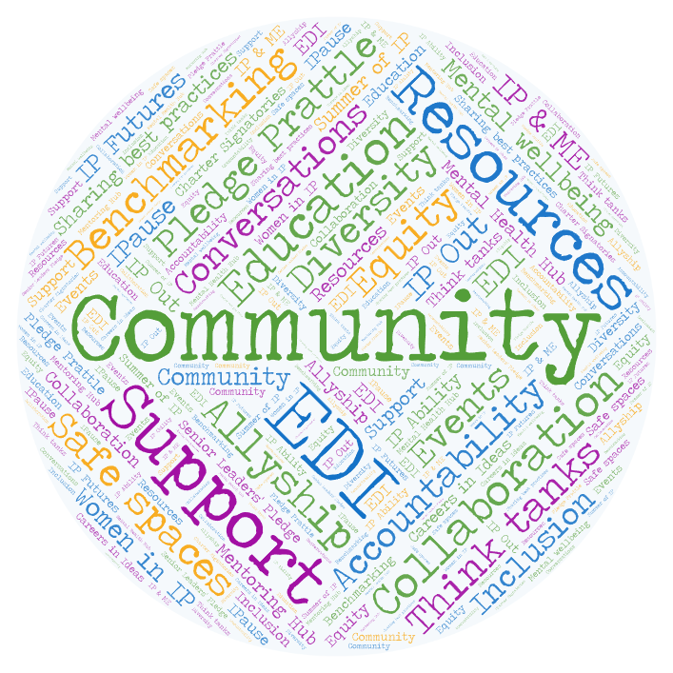
WHAT’S NEXT?
Key to IP Inclusive’s impact is the strong community it has created, in which IP professionals can work together for the things they value.
It’s a community that offers support, safe spaces, insightful conversations, great ideas, and vast amounts of enthusiasm and energy. These are the things that IP Inclusive can channel into positive change. They will be vital to our continuing success.
The over-arching theme for our 2025-27 business plan, which we’ll publish in July 2025, will therefore be “community”. As we embark on our second decade, we will continue to strengthen and support the IP Inclusive community and increase its impact on EDI and wellbeing in our sector. We’re looking forward to working with you on that. Thank you for being with us.
Andrea Brewster OBE – Lead Executive Officer

Slide 16
WITH THANKS
“This 2025 Impact Report is a testament to the way in which IP Inclusive contributes to empowering individuals and broadening perspectives in the IP professions. It provides insights into the wonderful power of supporting one another, pressing for change and trying to see the world from the shoes of others. Thank you to all those who have contributed to the last 10 years and to all those who will contribute in the years to come.”
James St Ville KC – Chair, IP Inclusive Management
To all our many volunteers, donors, event hosts, partners and other supporters
www.ipinclusive.org.uk | www.careersinideas.org.uk

